Slide 1
Rural innovation?
The success of renewable energy investments in rural areas
Honvári Patrícia
Socio-economic, environmental and regional aspects of a circular economy (CE)
Pécs, 19-20th April 2018

Slide 2
Theoretical background
Rural innovation: such novelty in the economic or social life of rural areas, which gives an added value to the quality of life (Mahroum et al 2007)
Something new, that is integrated into the local economy, and also the local community needs to be renewed
Starting point: rural problems, challenges – shortage (G. Fekete 2001)
Aim: generate development, increase the well-being
Renewable energy utilization = rural innovation?
What are the added value (benefits) of renewable energy utilization at rural areas?
Economic innovation
Social innovation
Integrating and utilizing the local capital into the development process.
Realizing such co-operations, that are able to prepare the local community for the reception of the novelty.

Slide 3
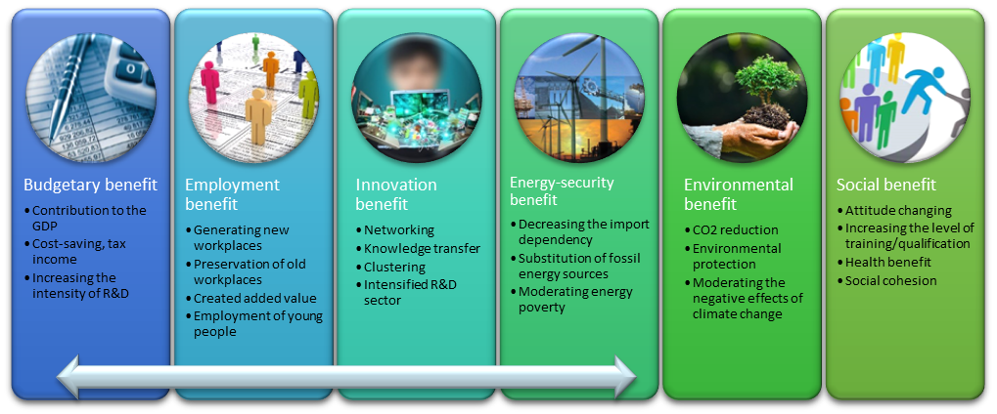
Benefits of renewable energy utilization at rural areas
Source: own editing
Economic benefit

Slide 4
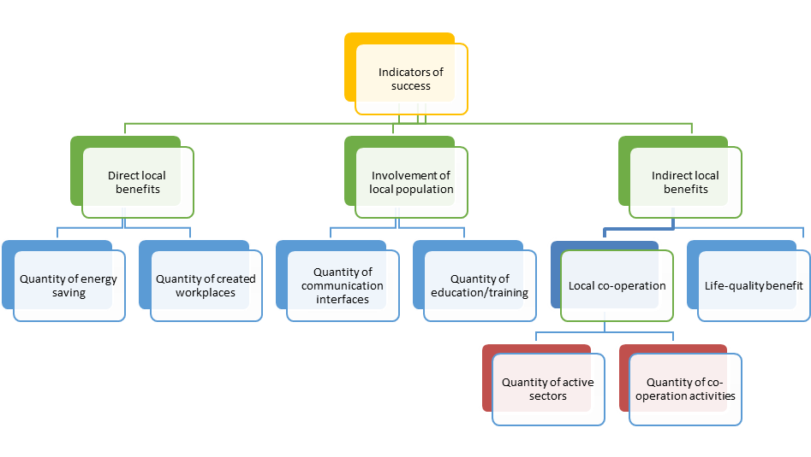
The success of renewable energy investments at rural areas in Hungary
How can you measure the success?
Evidences of an empirical study (examining 165 municipalities, 434 renewable energy projects) – defining 7 indicators that are able to represent the level of success

Slide 5
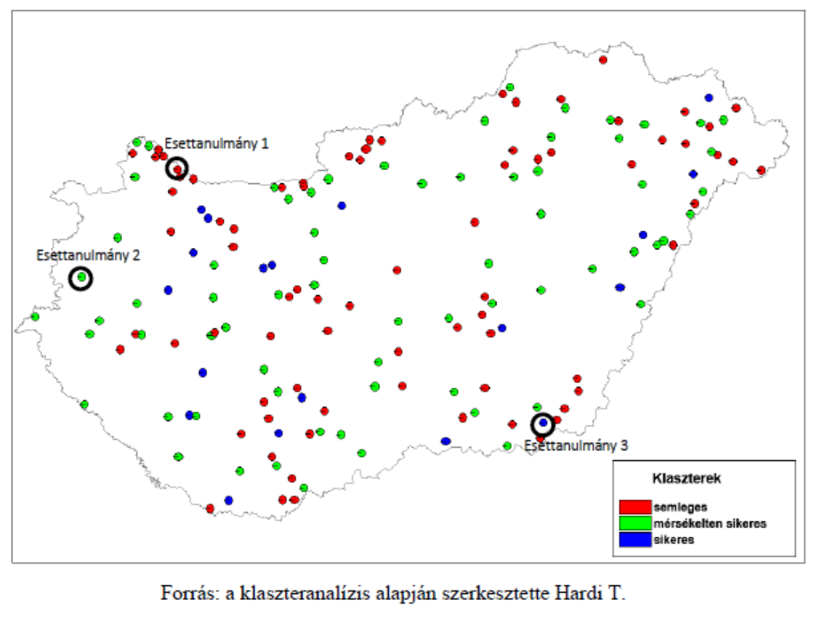
Results of the cluster analysis
Case study 1
Case study 2
Case study 3

Slide 6
Case-study analysis
What differences can be observed in the three case studies?
„I will be honest. I think this [the environmental aspect] did not matter that much here. Let’s say only in a negligible level. (...) There are only very few settlements, who can think like this: yes, I am doing this [the renewable energy investments] so that it will be better in 20, 40 years for those who live here.”
“Besides the energy saving, it makes us proud, that we try to take the first steps along this way. From whom can it be expected to show good example for the local population, if not from the local government? I am convinced that yes, the role model of the government can be an example to follow.”
“The conscious life, the consciousness needs to be handed over to the people. We do not necessarily have to show the technological knowledge. They do not have to understand the technological side. The communication, that is necessary for the development of the local community, is given here. For this, it is necessary, that the local government shows the example.”
Mayor of neutral settlement
Mayor of moderately successful settlement
Mayor of successful settlement

Slide 7
Case-study analysis
Aspects | Neutral | Moderatley successful | Succesful
Territorial features (RES potential) | given | given | given
Mentality of the local population | indifferent | new incomers (different attitude) | self-sufficiency
Initiator of the investments | mayor | mayor | mayor
Motivation of the mayor | economic benefits | environmental values | self-sufficiency
Local positive benefits | cost benefits | cost benefits and awareness raising | cost benefits, strong social benefits
Local population involvement | one experimental forum | regular information (forum and local newspaper) | complex awareness raising, two-way activity

Slide 8
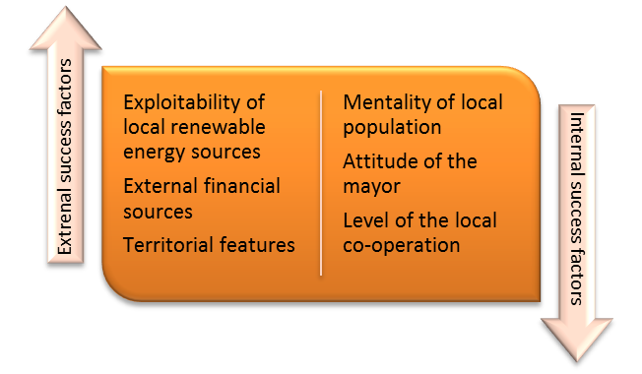
Conclusion
The local benefits are (in general) moderately presented – the positive process has started (i.e. rural innovation).
According to the analysis of success, indeed there are differences between the settlements who implemented renewable energy projects – some are more successful than others
What can be the factors of success?

Slide 9
Thank you for your attention!
honvari.patricia@rkk.hu

