Slide 1
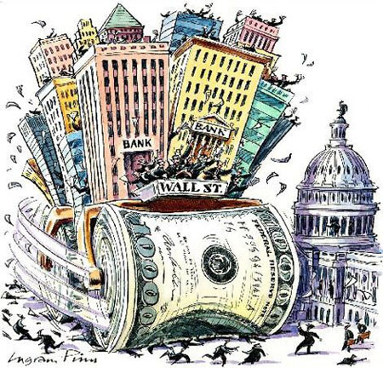

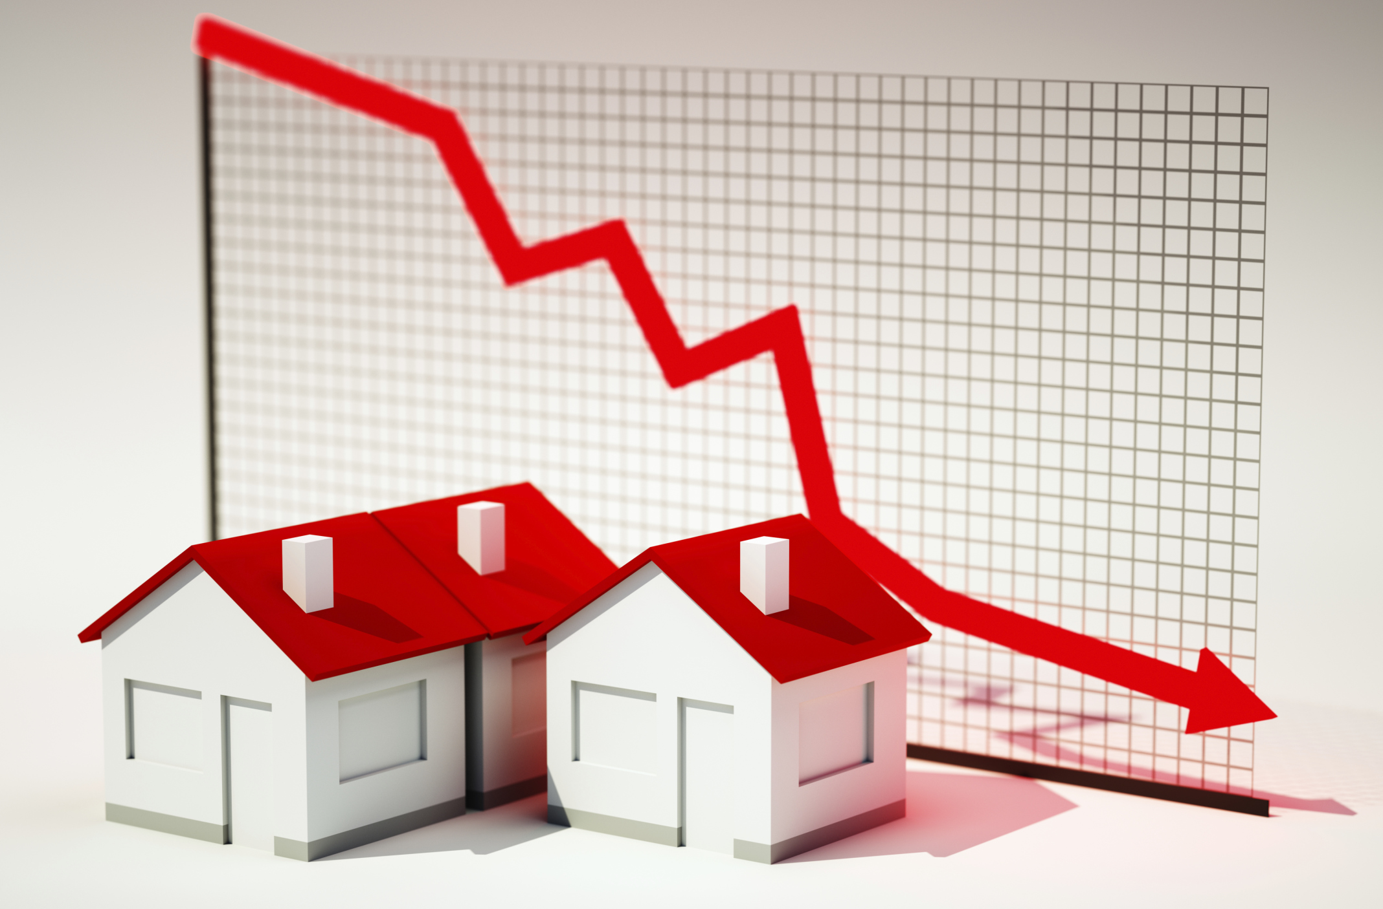
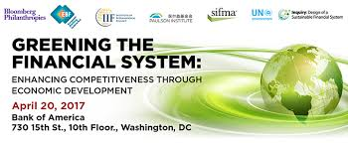
SUSTAINABILITY OF THE INTERNATIONAL FINANCIAL SYSTEM: Global, regional and local solutions
Prof. Zoltán Gál
Kaposvár University,
Centre for Economic and Regional Studies of Hungarian Academy of Sciences,

Slide 2
Contents
Context: Financial globalization– Financialization
Finantial Innovation: decline of traditional banking and the Rise of FinTech
  Crowdfunding,
  Digital currencies
Sustainable (green) finance
Local solutions _ community currencies

Slide 3
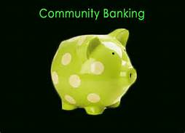
Players
Mainstream banking systems’ streams
Green banking
Ethical banking
Sustainable banking
Alternatives to mainstream systems
Local community currency
Co-operaive banking
Islamic banking
Community Banking

Slide 4

SUSTAINABLE FINANCE AND GREEN BANKING:
IS SUSTAINABILITY PROFITABLE?
Slobodan Rakić, PhD Kaposvar University
Assistant Professor Faculty of Economics 07.11.2017.

Slide 5
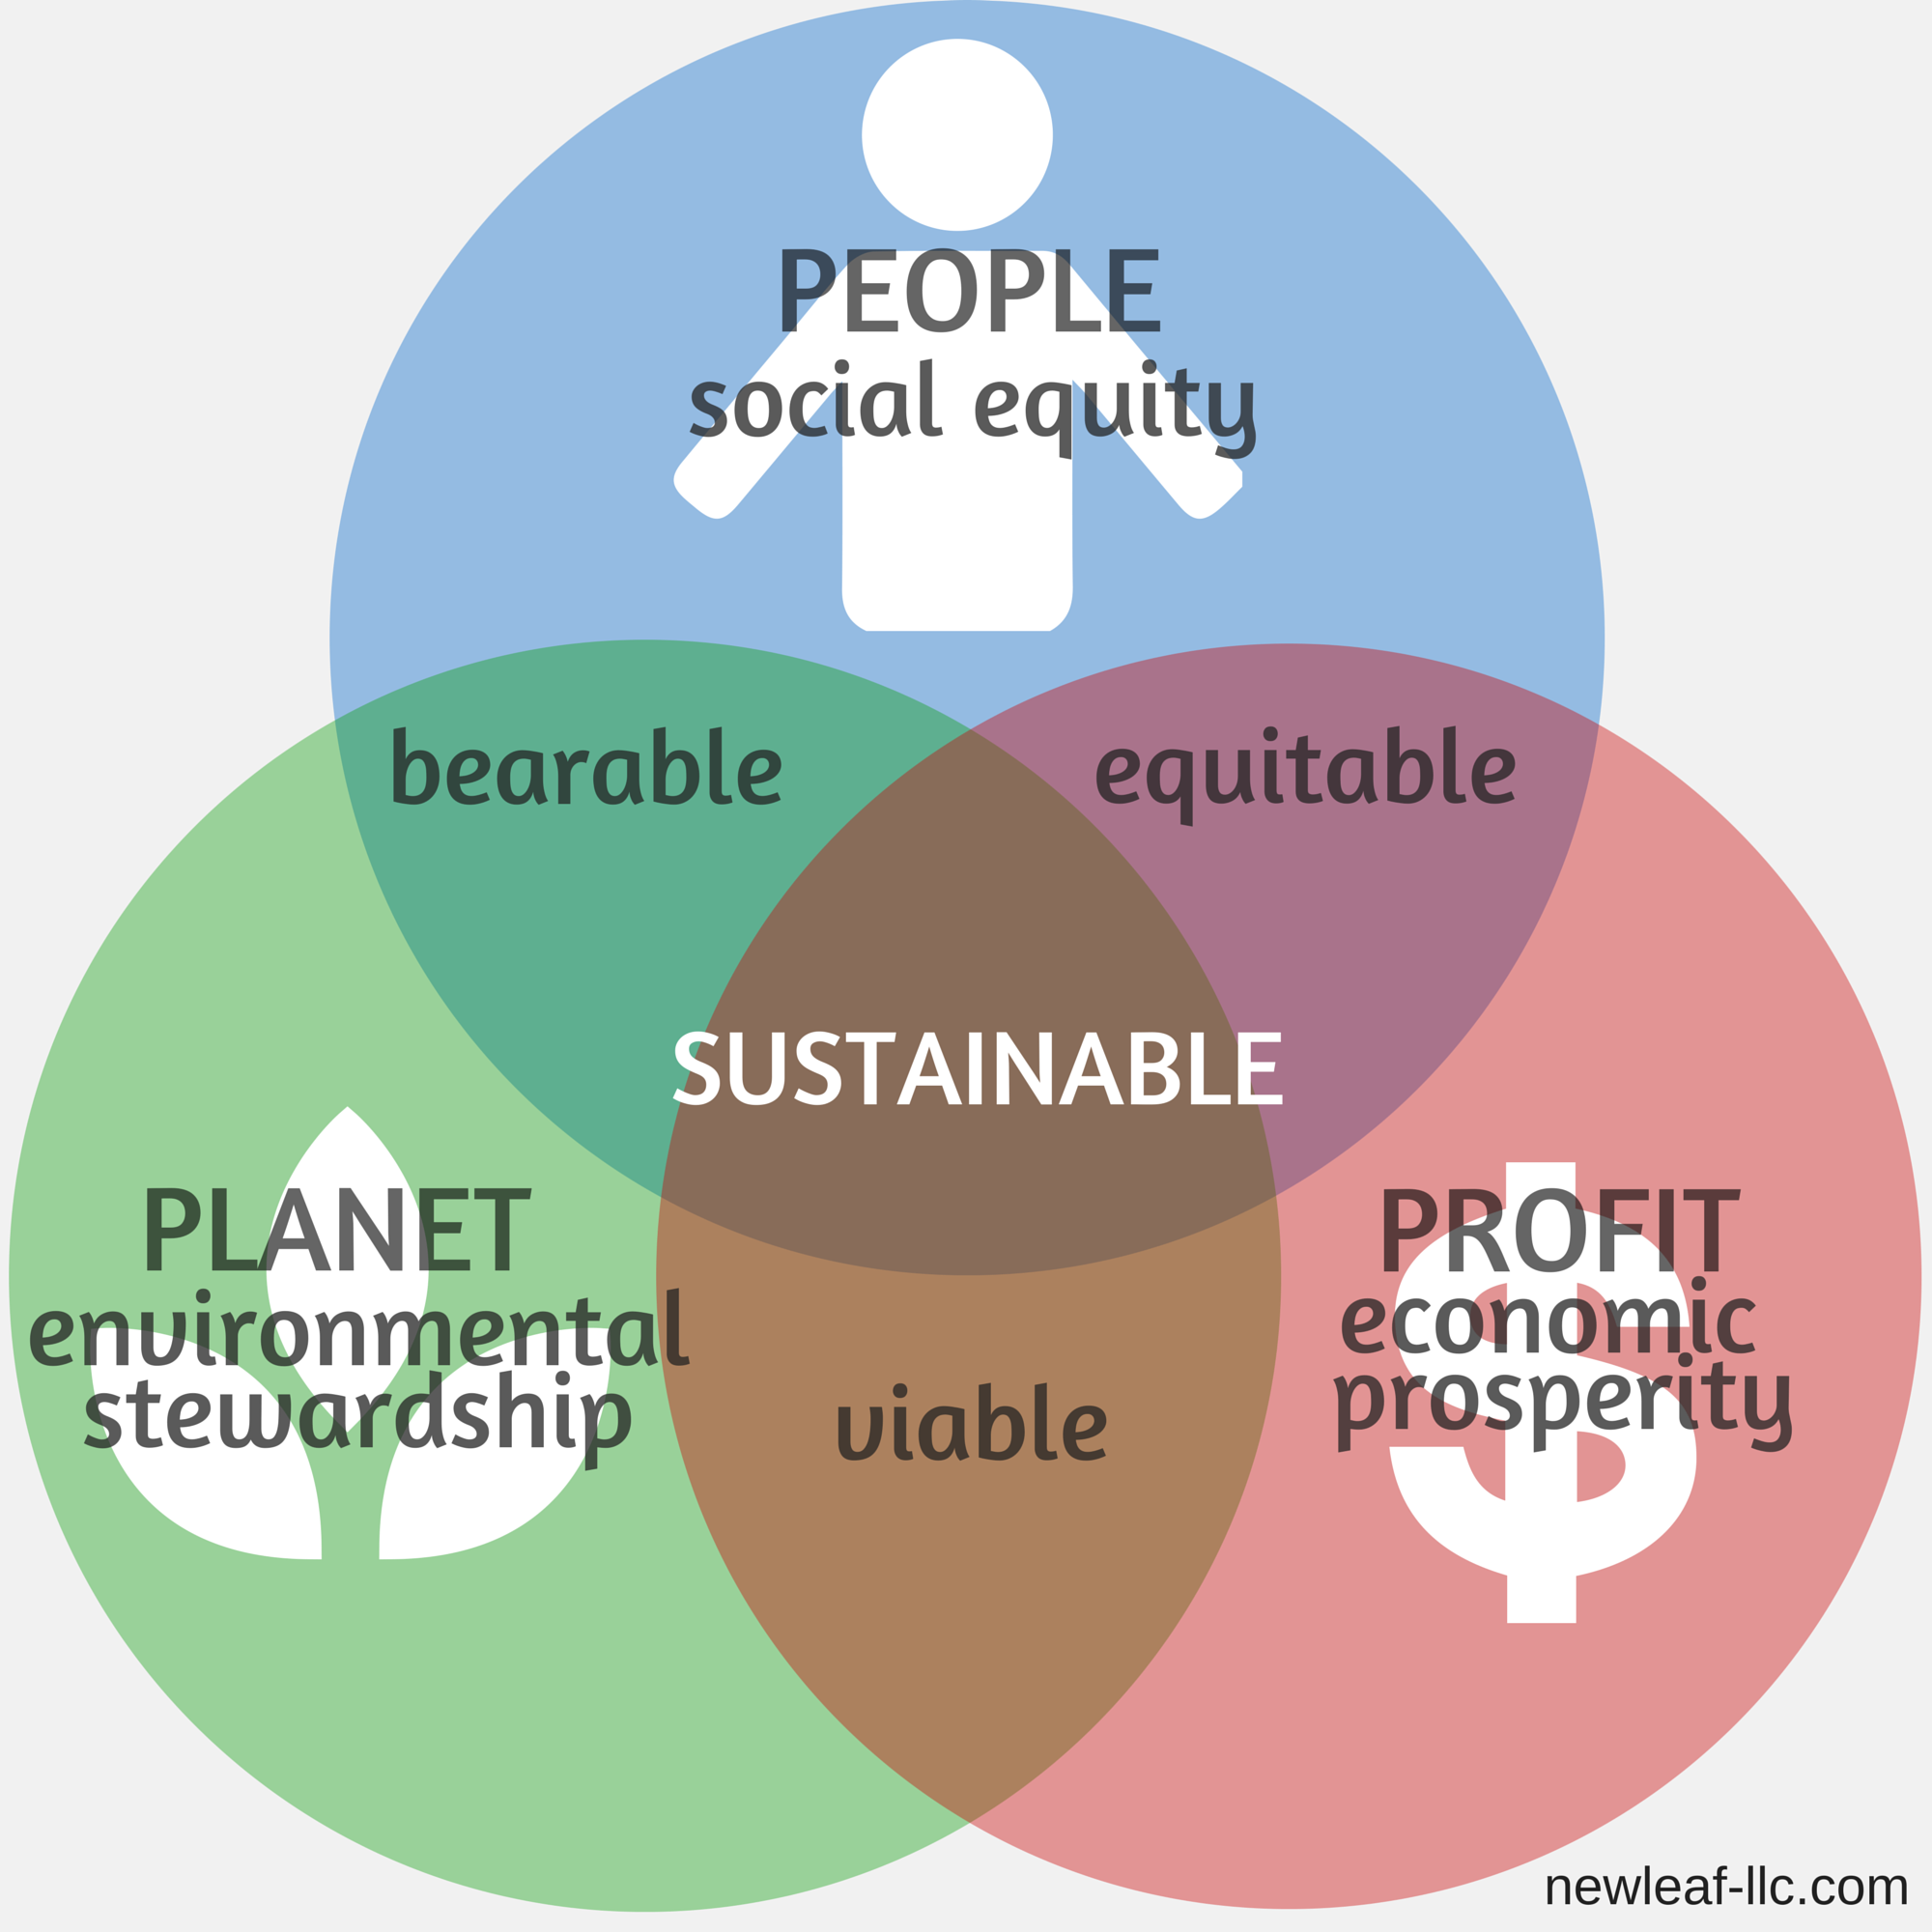
Triple bottom line concept in sustainability

Slide 6
Transformation of banking
  Competition in modern banking
  The Influence of IT on Modern Banking
  New types of modern banks: green banks, ethical banks
  Introduction of socially responsible business into banking
      There are also cases where banks are directly responsible for the adverse impact on the environment caused by the activities of their clients.
      Banks are usually not considered as direct environmental polluters, but indirectly they can be held accountable if they lend money to clients whose activity has negative consequences for the environment. The most famous case that shook up banking theory and practice is The US versus Fleet Factors Corporation of 1991.
      The concept of sustainable development and socially responsible banking is precisely about collecting and placing money without losing sight of social, natures and economic motives

Slide 7
Sustainable development and Corporate Social Responsibility
Sustainable development as a generator of corporate social responsibility
  „CORPORATE SOCIAL RESPONSIBILITY IS SUSTAINABLE DEVELOPMENT ON MICRO LEVEL, RESPECTIVELY LEVEL OF A INDIVIDUAL COMPANY"
Notes:
Rio de Janeiro "United Nations Conference on Environment and Development", 1992 - 178 countries and several thousand representatives of the non-governmental sector - first mentioned sustainable development
Johannesburg, 2002, entitled "World Conference on Sustainable Development", which emerged from the Declaration on Sustainable Development. "United Nations Conference on Sustainable Development", Rio de Janeiro 2012
New York September 25-27, 2015 - adopted the plan "Transform our world - Agenda 2030 on Sustainable Development". 17 objectives of sustainable development are defined.

Slide 8
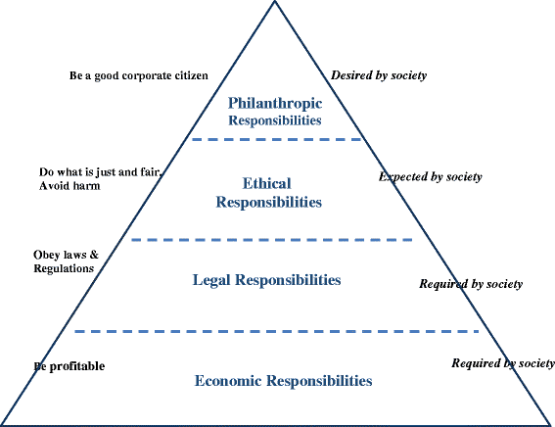
Sustainable development and Corporate Social Responsibility
Corporate Social Responsibility
Creation and development of theoretical approach to CSR
  In theory, the idea of ​​CSR was first met in 1899 in the work of the "Gospel of Wealth," written by Andrew Carnegie. He was the first to talk about the need of the company to help and improve the society and the environment in which it operates.
  The first definition of 1953-Howard Bowen, which reads "The duty of a businessman is to strive with such policies, decisions and activities that are desirable within the goals and values ​​of our society"
  Until the 1970s, the emergence of multinational companies resulted in the development of socially responsible business due to the high pressure that started on these companies.
  The most important model of corporate social responsibility was developed by A.B. Carroll in 1991, and is in the shape of a pyramid, because she thought she was helping to see the connection of all determinants.

Slide 9
3. Green “Sustainable” Banking
The United Nations Financial Initiative Program
  "The financial sector can play a key role in the transformation towards a sustainable environment. As financial intermediaries in the economy, financial institutions can contribute to ease of environmental problems, while using the opportunities that sustainability offers to the sector “
Green finance is positioned in a cross-section between the financial industry, environmental protection and economic development
GREEN FINANCE
Financing green enterprises and technologies
Development of green financial products and green investors
Consideration of environmental risks in lending decisions
Efficient operation of emission trading market
FINANCIAL INDUSTRY
Development of new financial products
Financing for more industries and technologies
Advancement of risk management techniques
Efficient operation of emission trading market
ECONOMIC GROWTH
Development of new technologies
Promoting of "eco-friendly" industries
Design of efficient emission trading scheme
ENVIRONMENTAL IMPROVEMENT
Better environment through green industries
Legislation for a better environment
Actively-trading carbon market

Slide 10
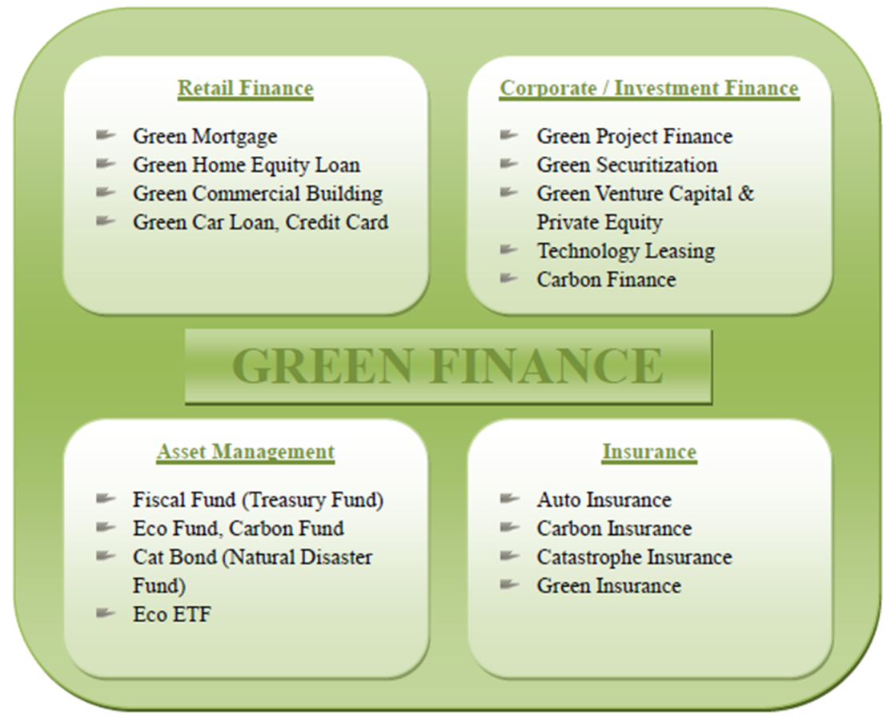
Green products and services in the financial sector
  There are three levels of "greening" business within financial institutions.
    The first level refers to the influence of the institution itself from the regular business.
    The second level of "greening" is the process of introducing new financial products and services
    The third and highest level represents the introduction of a social and environmental management system
SOCIALLY RESPONSIBLE PRODUCTS AND SERVICES IN FINANCIAL SECTOR
Retail Banking and Microenterprises
- Microfinance for Poor and Vulnerable Population
- Socially Responsible Loans and Deposits
- Mortgage Loans
- Private Investments
Corporate and Investment Banking
- Payment System, Savings and Current Accounts
- Investment Banking
- Commercial Loans for Socially Responsible Projects
- Loans for Entrepreneurs
Asset Management
- Social Impact Bonds
- Impact Investment Funds
Insurance
- Life Insurance
- Insurance for Non-profit and Humanitarian Organizations
- Specific Forms of Insurance
Notes:
There are three levels of "greening" business within financial institutions.
The first level refers to the influence of the institution itself from the regular business. This implies the introduction of online access to financial services that helps to reduce direct business impact. Sustainable practices in the business of institutions contribute to the "greening" of business, but they are only the first step and their significance has no far-reaching consequences.
The second level of "greening" is the process of introducing new financial products and services, expanding the range of banking services and specifically targeting "sustainable" practices that aim to contribute to the preservation of the living and social environment.
The third and highest level represents the introduction of a social and environmental management system, which aims to measure the impact of its clients and all business partners on the social and environmental environment in addition to measuring the direct impact of business, offering new products and services. The ultimate goal of the third level would be that individual institutions, and through them, the whole financial sector, implement socially responsible business as part of their regular business.

Slide 11
3. Green “Sustainable” Banking
Examples of banks with the best social and environmental management systems
NEDBANK group
The social and environmental management system of Nedbank is based on the ISO 14000 standard, the best practices of the IFC and the Equatorial Principles.
The program contains policies, procedures, resources and workflows that are responsible for identifying and assessing impeded social and environmental impacts on the lending activities of the bank.
https://www.youtube.com/watch?v=7Rnih3MxCQA
Any negative impact on the social and natural environment is triggered by a mechanism aimed at removing these negative effects.
The mechanism involves the analysis: social and environmental; specific guidelines in the field of economy; relevant local, regional or national legislation; review of relevant public information portals; communication with relevant civil servants; visits to endangered areas, etc.
Notes:
The social and environmental management system of Nedbank refers to mining, real estate, water infrastructure, waste disposal, oil and gas, agriculture and biodiversity. A special screening system has been developed in all branches of the bank that relate to large investment projects.

Slide 12
3. Green “Sustainable” Banking
Types of social loans and securities
https://www.youtube.com/watch?v=8eb8ivuqOoQ
TYPE OF LOAN | PURPOSE OF THE LOAN
Education | Improvement of education system Assistance to vulnerable social groups to obtain quality education
Crime rate and public safety and security | Reduction of the crime rate due to preventive action Reducing the rate of recidivist Education and training of inmates
Social Housing | Reducing the number of homeless people Improvement of living conditions
Healthcare | Improving public health Preventive actions Reducing the use of harmful substances
Sport activities and youth | The construction of sports centres and promotion of sports Sports event organization
Art and Culture | The construction and renovation of art and cultural institutions Promoting culture and art through organization of different events and manifestations
Local and Municipal Affairs | Improvement of public utility services such as public transport, parks and other content Improvement of public administration
Employment | Employment of people with disabilities or people with mental illnesses
INSTITUTION | TYPE OF ACTIVITY | AMOUNT | DESCRIPTION
Thera Trust | Bond issue | £2,000,000 | Bond offer to retail investors for a national charity that provides support to people with a learning disability.
Glasgow Together | Bond issue | £2,000,000 | Bond offer to investors for a social enterprise that employs ex-offenders to build and renovate properties.
Aspire Gloucestershire | Social Impact Bond | £310,000 | Private placement to investors for a payment-by-results programme which aims to tackle youth homelessness.
Ebsi | Loan and Equity | £350,000 | Private placement that supports commissioners develop SIB which aim to improve the lives of disadvantaged children.
GLL | Bond issue | £5,000,000 | Bond issue for charitable social enterprise in the health and leisure sector.
Bristol Together | Bond issue | £1,600,000 | Private placement for social enterprise supporting major programme of job creation for ex-offenders.

Slide 13
3. Green Community Banking
Types of socially responsible banks
Terminologically speaking, there are more names for green “sustainable” banks. In theory they are called "ethical", "alternative", "green" and "sustainable" banks.
These are the dominant terms used for banks that incorporate into their business all elements of a socially responsible business or sustainable development.
  Charity bank
  https://www.youtube.com/watch?v=nlC0qZrisKI
  Green Investment Bank:
  https://www.youtube.com/watch?v=RfRzzjQBxEA
  Tridos Bank:
  https://www.youtube.com/watch?v=ktBz6uu8oXI
  https://www.youtube.com/watch?v=AwdL9dZX_S4
  https://en.wikipedia.org/wiki/Triodos_Bank
Banks can be divided into:
defensive - ignore social and environmental problems,
preventive - take care of the social and environmental problems in terms of prevention,
offensive - takes care of social and environmental problems to a greater extent by developing new products and services,
sustainable - they take full care of the social and natural environment.
Notes:
However, it is necessary to distinguish between products and services that can be considered socially responsible and institutions that have fully incorporated the principles of corporate social responsibility into their business so that they can be called. Different financial institutions, and in that sense banks, incorporate certain elements of corporate social responsibility, which does not automatically make them socially responsible, green or ethical, given that there is a whole range of business activities of those institutions that are not covered by socially responsible control and reporting, They can not be called socially responsible banks.

Slide 14
Magnet Bank, Hungary
What makes us a community bank?
„The owners, executives and employees of the bank mutually arrived at the conclusion that the time had come for placing banking operations on a new foundation, and in 2010 they designed the new strategy together. By applying the principles of organic organizational development, after one year we jointly set our fundamental principles of performing banking operations in the most transparent manner possible, making business decisions and taking responsibility based on the principles of sustainability, and we also invented how to provide our clients with the right to have a say in the bank’s community activities. We performed the strategy change in such manner that the traditional banking values and objectives could be retained as well.”
https://www.magnetbank.hu/en/about-the-community-bank

Slide 15

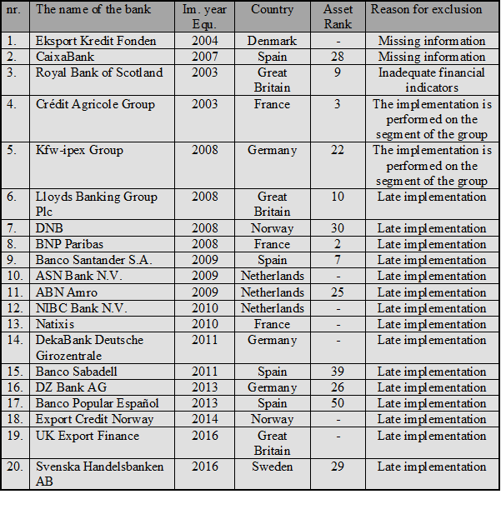
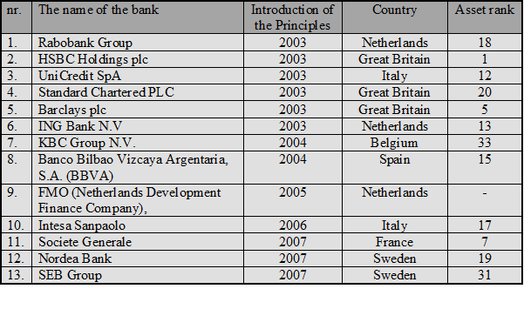
The equator principles constitute an international voluntary code developed by banks to encourage consideration of environmental and social issues in project financing
It is a risk management framework, adopted by financial institutions, for determining, assessing and managing environmental and social risk in projects
This framework is global business specific self-regulation that came into force in 2003 so far it has grown to 85 institutions that come from 35 countries
Notes:
Advisory services on project finance - with a minimum capital of $ 10 million
Project financing - with a minimum capital of $ 10 million
Project related business loans - most of the funds must be used for the project, the total loan must be over $ 100 million, an institution that follows the Equity Principles must provide a minimum of $ 50 million in the form of a loan and with a minimum repayment of 2 years.
Bridge loans - all of the criteria as for the above mentioned projects are valid, with a two-year time limit on the conversion of Bridge Loan into a project loan

Slide 16
Quantitative analysis
DATA ANALYSIS
Analysis Results
The results of the research of the return on equityshow that Equator banks that implementedthe system by 2007 are significantly more profitable in relation to the rest of the EU sector.
The results of the relationship between Equator Banks and the top 43 EU banks show slightly different results. Although the rate of Equator Banks by this indicator is at 0.5% for 10 years, this amount is not significantly higher than the amount of this indicator for the top 43 EU banks, which amounts to 0.05% annually.
The most significant indicator of profitability, return on equity ROE, in both cases shows a significant difference of 7.2% for the EU sector, and 6.8% for the top 43 banks. However, the annual average for the EU sector is 0.9%, while for the top 43 EU banks it is 0.68%.
It is interesting to note that the results of operating income and operating costs are almost identical when it comes to both groups of banks
Notes:
The results of the survey of return on equity capital show that Equatorial banks that implemented the system by 2007 are significantly more profitable than this indicator in relation to the rest of the EU sector.
The results of the relations between Equatorial banks and the top 43 EU banks show slightly different results. Although the rate of Equatorial Banks by this indicator is higher at 0.5% for 10 years, this amount is not significantly higher than the amount of this indicator for the top 43 EU banks, which amounts to 0.05% annually. It is important to note that although ROA is low, in absolute terms, this figure represents a significant difference in this profitability indicator. Also, the ROA indicator has a significantly lower rate than ROA, given that the amount of capital is always drastically lower than the amount of total assets. Also, the ROE indicator can more accurately and accurately show the real profitability rate.
The most important indicator of profitability, return on equity ROE, in both cases shows a significant difference of 7.2% for the EU sector, and 6.8% for the top 43 banks. However, the annual average for the EU sector is 0.9%, while for the top 43 EU banks it is 0.68%. These results are also expected, as the top 43 banks are in the same group of assets together with Equator Banks and it is expected that the profitability rates will be higher for the group of the top 43 EU banks than for the rest of the EU sector.

Slide 17
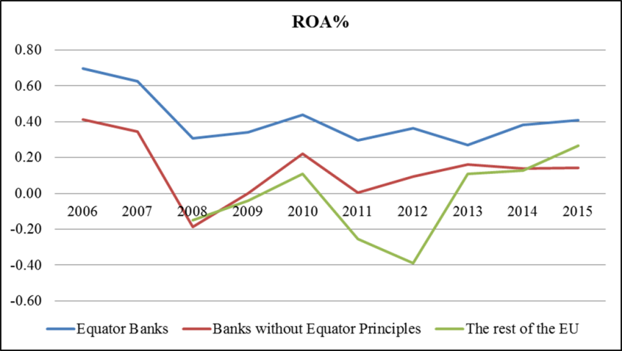
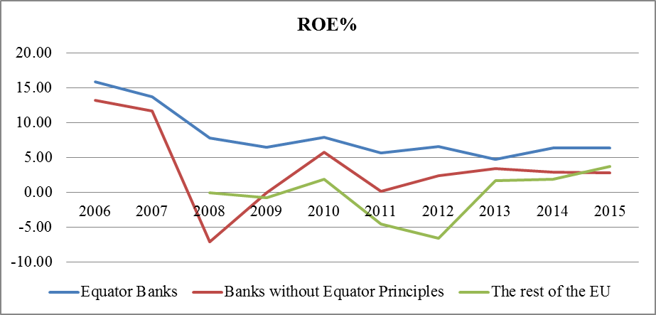
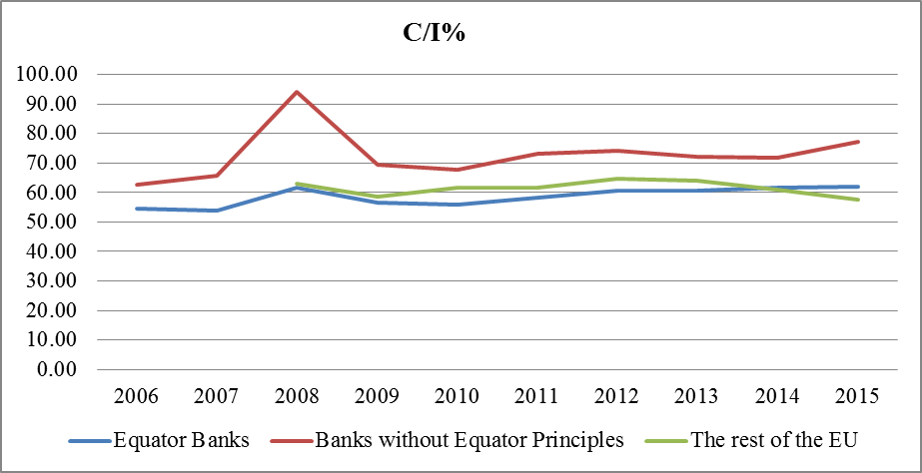
Quantitative analysis
ROA in period 2006/2008 – 2015 with three analyzed groups
ROE in period 2006/2008 – 2015 with three analyzed groups
C/I in period 2006/2008 – 2015 with three analyzed groups

Slide 18
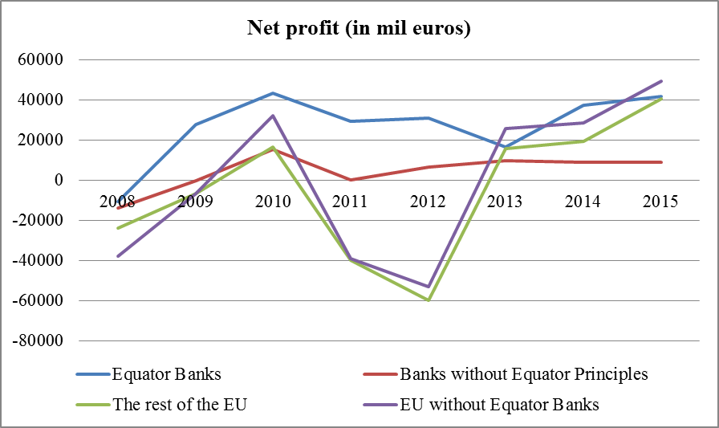
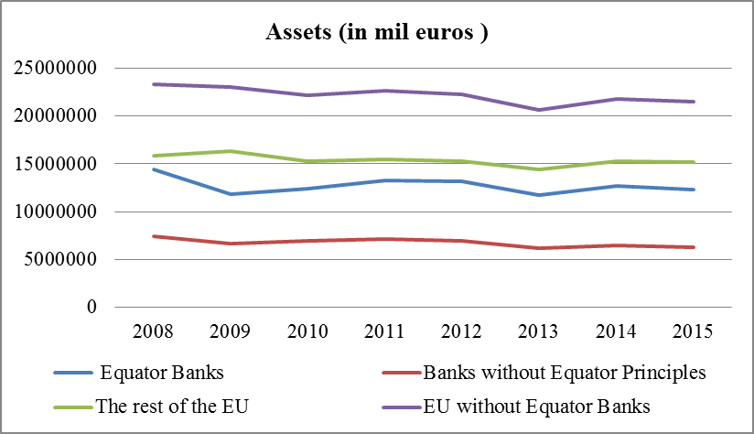
Quantitative analysis
Year | Equator Banks | Banks without Equator Principles | The rest of the EU | EU without Equator Banks
Net profit (in mil euros)
2008 | -10.601 | -13.869 | -23.881 | -37.702
2009 | 27.773 | -33 | -6.672 | -6.644
2010 | 43.414 | 15.514 | 16.525 | 32.165
2011 | 29.289 | 347 | -39.597 | -39.156
2012 | 31.154 | 6.664 | -59.607 | -52.798
2013 | 16.720 | 9.856 | 15.808 | 25.797
2014 | 37.430 | 9.023 | 19.346 | 28.493
2015 | 41.924 | 8.897 | 40.425 | 49.496
Year | Equator Banks | Banks without Equator Principles | The rest of the EU | EU without Equator Banks
Assets (in mil euros)
2008 | 14.468.757 | 7.407.035 | 15.895.009 | 23.305.698
2009 | 11.837.214 | 6.638.064 | 16.372.058 | 23.013.893
2010 | 12.431.100 | 6.954.208 | 15.264.091 | 22.222.604
2011 | 13.286.946 | 7.140.490 | 15.510.997 | 22.656.547
2012 | 13.216.151 | 6.955.395 | 15.312.285 | 22.273.244
2013 | 11.787.483 | 6.163.680 | 14.440.024 | 20.609.888
2014 | 12.708.772 | 6.478.677 | 15.303.157 | 21.788.922
2015 | 12.319.924 | 6.292.581 | 15.185.925 | 21.486.927

Slide 19
THANK YOU!

Slide 20
2 Group work
  Green investments
  Tridos Bank:
  https://www.youtube.com/watch?v=AwdL9dZX_S4
  https://www.youtube.com/watch?v=0kSWrHf2m1g
  https://www.youtube.com/watch?v=VRP5E0EF8kc
  https://en.wikipedia.org/wiki/Triodos_Bank
  What does the sustaibale bank invest in?
  How a sustainable bank is different from mainstream banking?
  What is the local and socio-economic impacts of green banking?
  What extent green or ethical banking is different from other sustainable banks? (See Investing with Impact, article )
  Green Investment Bank:
  https://www.youtube.com/watch?v=RfRzzjQBxEA
  Ethical banking
  https://www.youtube.com/watch?v=XdWEcQGAyIQ

Slide 21
3 Group work:
Magnet Bank: the community bank
https://www.magnetbank.hu/en/about-the-community-bank
What kind of activities do make the MagNet Bank a community bank?
How does it involve its costumers to invest or donate to good (sustainable) things? https://www.magnetbank.hu/en/about-the-community-bank/donate-from-the-banks-profit
What kind of innovative and sustainable products did the Magnet Bank develop?

