Slide 1
Local complementary currencies: linking circular economy to local development policy
Csaba Lakócai
PhD student, junior research fellow
University of Pécs (Hungary)
Faculty of Economics, Institute of Economic and Regional Studies
Centre for Economic and Regional Studies, Pécs
lakocai.csaba@ktk.pte.hu; lakocai.csaba@rkk.hu
Pécs, 20 April 2018

Slide 2
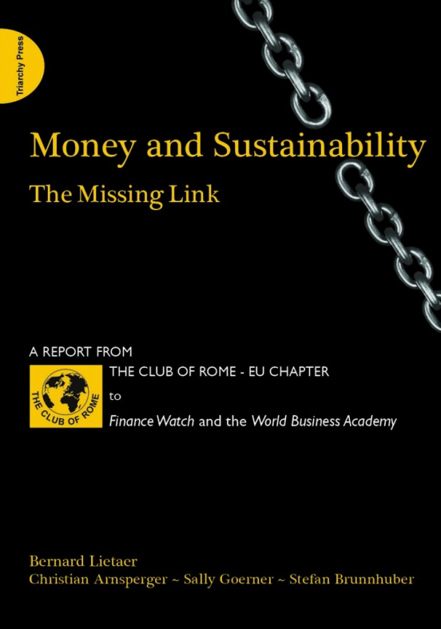
Theoretical framework
Idea of monetary diversity: Money and Sustainability: The Missing Link by Lietaer et al, 2012.
Systemic structural failures and the main negative effects
of the current monetary system:
Amplification of boom and bust cycles
Short-term thinking
Compulsory growth
Concentration of wealth
Devaluation of social capital
Using different kinds of currencies for differend kinds and
scales of issues is a precondition of sustainability

Slide 3
Local complementary currencies as money substitutes
Two groups of monetary surrogates:
technical cash equivalents (e.g. bank cards, credit cards, vouchers, e-wallet, reward points etc.)
money substitutes as alternative currencies (on-line digital assets, local currencies, mutual credit systems)
They are usually free of interest or have negative interest rates (demurrage):
they do not fill the function of official money as tool of hoarding in order to better facilitate their function as medium of exchange
the main goal is to better use the local capacities and resources according to the local demands
(Silvio Gesell: The Natural Economic Order, 1916)

Slide 4
Social banks, sustainable finance and circular economy I.
Products and services of sustaible finance (Weber, 2011):
sustainable loans
socially responsible investment
carbon finance
sustainability saving accounts
microfinance
project finance
Local complementary currencies can be seen either as products themselfs or as tools for the implementation of the products of sustanable finance
Some products and services are offered by both social and conventional banks while some others are only by alternative finacial institutions
What about local currencies?

Slide 5
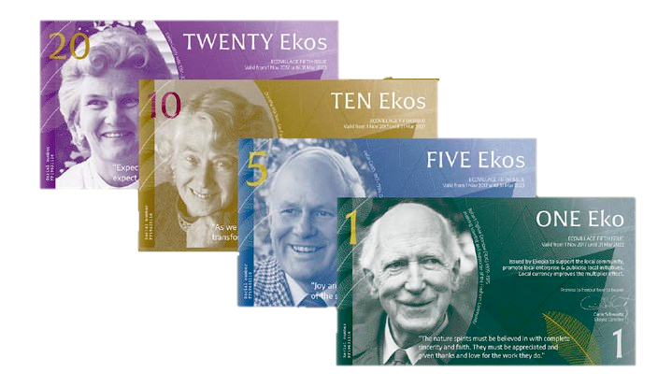
Social banks, sustainable finance and circular economy II.
Local currencies can internalize externalities (in some cases better than legal regulation does) going beyond the logic of conventional finance;
local and regional currencies are basically issued by cooperatives
general institutional transition is indispensable to sustainability in the long run
Some existing local/regional currencies mainly with circular economy objectives:
EKO, Findhorn, Scotland
NU card, Rotterdam, the Netherlands
E-Portemonnee, Limburg province, Belgium
etc.

Slide 6
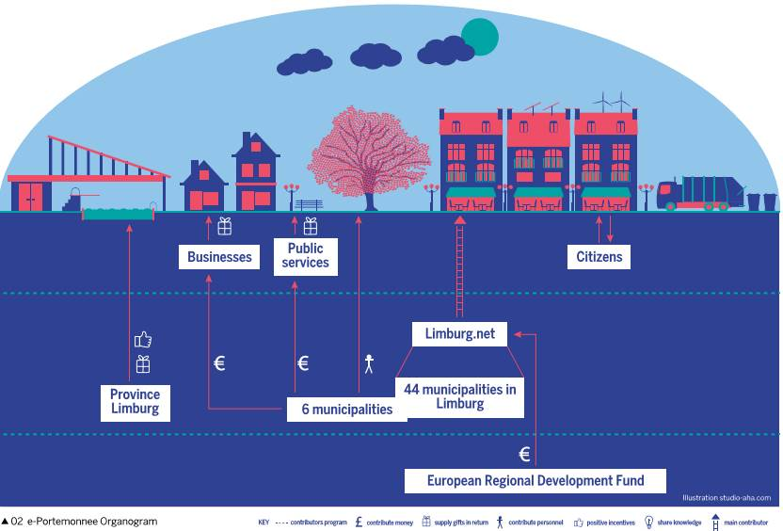
e-Portemonnee organogram (Source: NEF (2015): People Powered Money. p. 75)

Slide 7
Relations to broader EU policy framework
Shared “European vision of the cities of tomorrow”
United Nations’ 2030 agenda for sustainable development → EU’s 12 urban agenda themes – promoting circular economy
Europe 2020 strategy’s environmental dimension (green cities, green capital)
developing public transportation
improving pedestrian and cycling conditions
implementing urban renewal
fostering local environmental regeneration, etc.
However the EU policy context is not always consistent with itself (!)
Making the EU funds more tailor-made and place-sensitive – the potential link of the EU policy context and the local currency schemes
Local complementary currencies can facilitate the better fulfilment of EU policy objectives
→ How to measure?

Slide 8
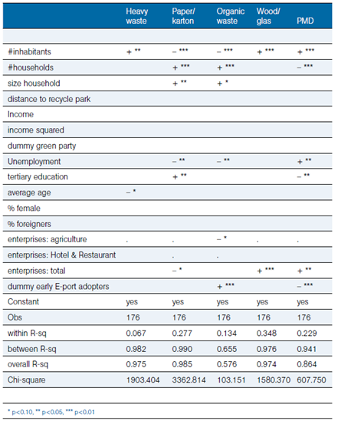
Panel regressions explaining the determinants of Kg waste per inhabitant, by waste product, 2009—2012, all Limburg Municipalities Source: New Economics Foundation, 2015

Slide 9
Main references
Blanc, J. – Perrissin-Fabert, B. (2016): Financer la transition écologique des territoires par les monnaies locales. Note de l’Institut Veblen.
Blanc, J. – Fare, M. (2013): Understanding the Role of Governments and Administrations in the Implementation of Community and Complementary Currencies. Annals of Public and Cooperative Economics, 1., 63-81.
Community Currencies in Action (Ed.) (2015): People Powered Money. Designing, developing & delivering community currencies. New Economic Foundation, London.
Kennedy, M. – Lietaer, B. – Rogers, J. (2012): People Money. The Promise of Regional Currencies. Axminster.
Lagoarde-Segot, T. (2014): La finance solidaire. Un humanisme économique. Louvain-la-Neuve: De Boeck
Lietaer, B. – Arnsperger, C. – Goerner, S. – Brunnhuber, S. (2012): Money and Sustainability. The Missing Link. A Report from the Club of Rome to Finance Watch and the World Business Academy. Triarchy Press, UK.
New Economics Foundation (2015): Money with a purpose. Community currencies achieving social, environmental and economic impact. Retrieved from: http://b.3cdn.net/nefoundation/ff0740cad32550d916_o1m6byac6.pdf
Weber, O. (2014): Products and services. In: Weber, O. – Remer, S. (Eds.): Social Banks and the Future of Sustainable Finance. London, New York: Routledge, pp. 96–122

