Slide 1
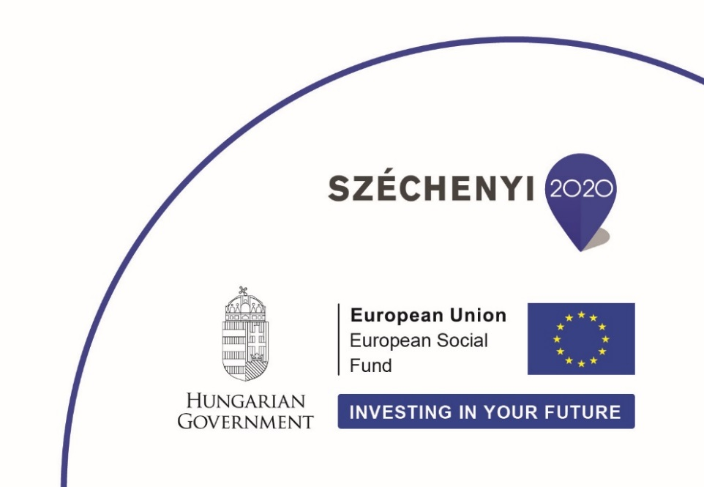
The role of future orientation in the acceptance and local implementation of renewable energies
Széchenyi 2020 program framework (EFOP-3.6.1-16-2016-00013) under the European Union project titled: ”Institutional developments for intelligent specialization at the Székesfehérvár Campus of Corvinus University of Budapest”
András Márton
Corvinus University of Budapest
andras.marton2@stud.uni-corvinus.hu

Slide 2
Content
Background and relevance
Research question and model
Methods
Results
Conclusion
References

Slide 3
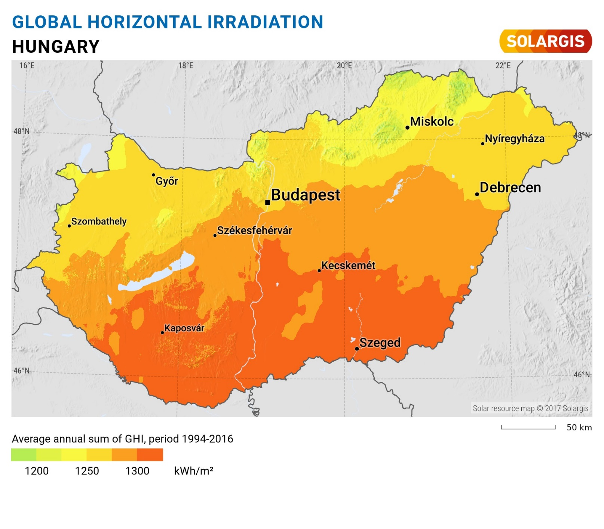
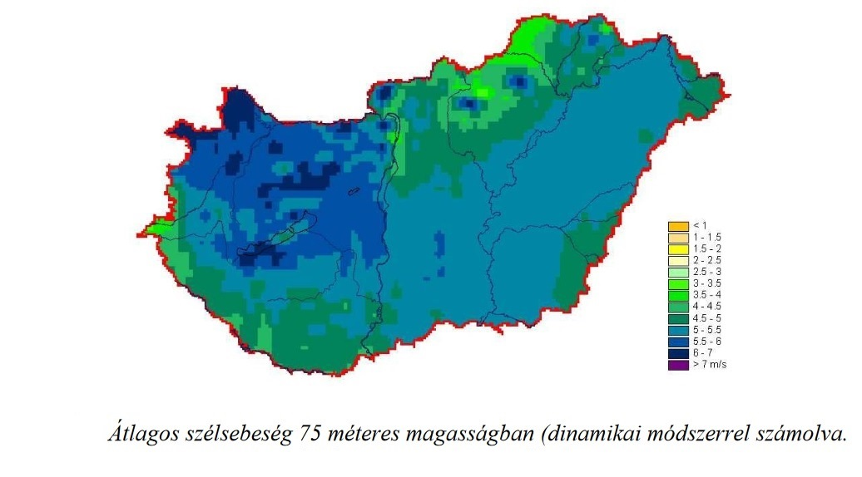
Background and relevance
Source:ª
Energy resources
Non-renewable → non sustainable
Renewable → sustainable
Good potential of renewables in Hungary (solar, wind and geothermal power)¹
Local economic development!^{3,4}
Energy = Strategic question
Average windspeed on 75 meters (dynamic calculation)
Source:² Hunyár et al. (2006), pp.101.

Slide 4
Background and relevance
Strategic horizon → long-term effects
Important and complex questions concerning the community’s future need social consensus⁵
Stakeholders: accept, support (see future alternatives!)
Green investments? Nuclear power? (see Paks 2 in Hungary) → timely economic and social questions

Slide 5
Research question and Model
How open and supportive people and local companies are to the use of renewable energy sources?
Future Orientation
Energy mix scenario
Renewable instead of non-renewable
Source: Author
[Nuclear denial]

Slide 6
Method
”…acceptance of renewables…” → scenario questionnaire (alternatives by selectors)
”local implementation of renewables…” → interviews
Scenario questionnaire: online (Hungary-wide)
Interviews: local companies of a city (industrial parks of Székesfehérvár) (case study)
+ Youth’s future orientation⁶ (case study)

Slide 7
Results
Scenario questionnaire:
Starting questions about personal attributes
Classify by future orientation: higher education + student/entrepreneur/top manager (high future orientation)⁷
40% BAU 60% Green Path
Next: specified scenarios according to answers to selector questions

Slide 8
Results
Source: Author
BAU 5 (40%)
GREEN 5 (60%)
Waste management
Collect everything as communal waste
Partly selective waste collection
Fully selective waste collection
Selective collection, plus recycle/reuse if possible
Energy dependence
Only domestic sources and production
Mainly domestic sources, partly import
Partly domestic and import sources
Mainly import sources, partly domestic production
Only import sources

Slide 9
Results
Source: Author
BAU 15 (26%)
GREEN 15 (74%)
Energy dependence
Only domestic sources and production
Mainly domestic sources, partly import
Partly domestic and import sources
Mainly import sources, partly domestic production
Only import sources
Green power plant nearby
Don’t want at all
Don’t want it nearby
I don’t mind if nearby or somewhere else
I support to build it nearby

Slide 10
Results
Source: Author
BAU 30 (19%)
GREEN 30 (81%)
Solar energy
I don’t want it
I want it
I already have it
Green power plant nearby
Don’t want at all
Don’t want it nearby
I don’t mind if nearby or somewhere else
I support to build it nearby

Slide 11
Results 2.
Further tendencies on Green Path: better financial status, lower overhead expenses, rather walking or electric car (+train etc.)
Interviews: preliminary results in Székesfehérvár (case study)
Poor in sustainable solutions, low number of green projects in development strategies
Public sector: optimism, openness, good examples
Private sector: sustainable solutions, CSR, energy strategy (big co.s) ↔ no renewables (but good waste management!), moderate CSR, basic planning (SMEs)

Slide 12
Results 3.
Youth’s future orientation: measured by paper-based questionnaire in Székesfehérvár (case study)
Elementary school students (13 year-olds)
Interested about future, their future depends on them, further education, many sports and other occupation → positive future attitude
Don’t plan their free-time, no independence in studying, no plans for future profession → moderate future orientation

Slide 13
Conclusion
Future orientation correlates with green behavior (the more oriented, the greener)
People tend to think about a greener future
Local companies are moderately future oriented: sustainability is a financial question
Future generation (youth): keep positive attitude, but should act more for the future

Slide 14
References
Sáfián F. (2014): Modelling the Hungarian energy system – The first step towards sustainable energy planning. Energy, Volume 69, 1 May 2014, pp. 58–66.
Hunyár M. – Veszprémi K. – Szépszó G.: Újdonságok Magyarország szélenergia potenciáljáról. [News on wind potential in Hungary] In: Magyarországi szél és napenergia kutatás eredményei. Dobi Ildikó (szerk.), Országos Meteorológiai Szolgálat, Budapest
Czene Zs. – Péti M. (2010): Helyi Gazdaságfejlesztés – Ötletadó megoldások, jó gyakorlatok. [Local economic development—Inspiring solutions, good practices] Területfejlesztési füzetek 2., NFM–NGM–VÁTI, Budapest
Cork 2.0 Declaration (2016). A Better Life in Rural Areas. Prepared by the participants of the European Conference on Rural Development in Cork, Ireland, 5-6th September
Nováky E. (2011): A participatív módszerek az interaktív jövőkutatásban. [Participatory methods in interactive futures studies] Jövőelméletek 18., Budapesti Corvinus Egyetem, Jövőkutatás Tanszék, Budapest
Hideg É. – Nováky, E. (1996): Jövőorientáltság-vizsgálat. [Future orientation analysis] Jövőtanulmányok 1., Budapesti Közgazdaságtudományi Egyetem, Jövőkutatás Tanszék, Budapest
Nováky E. (szerk.) (2010): Magyarország 2025. [Hungary 2025] Tanulmánykötet, Gazdasági és Szociális Tanács, Budapest
Source of picture:
https://solargis.com/maps-and-gis-data/download/hungary; 04.18.2018.

Slide 15
Thank you for your attention
Be future oriented!
Act sustainably!

