Slide 1
Regionalisation approaches in integrated assessment modelling
International Conference for the 75th Anniversary of DTI
19 April 2018
Pécs, Hungary
Zsuzsanna ZSIBÓK
research fellow, CERS HAS
zsibok@rkk.hu
Project no. 120004 has been implemented with the support provided from the National Research, Development and Innovation Fund of Hungary, financed under the K_16 funding scheme.

Slide 2
Research background
National Research, Development and Innovation Fund Project No. K16_120004
Long-run regional economic forecasting: a model-based approach for Hungary
Investigating methods that use a top-down approach to regionalise an existing macro-level (economic) forecast
Spatial downscaling is often conducted in the study of climate change impacts.
This presentation:
summarizes regionalisation method used in integrated assessment models

Slide 3
Integrated assessment modelling (IAM)
IAM is a key method in climate-economy modelling – energy-environment-economy models (EEE or E3 models)
Climate change economics
W. Cline's The economics of global warming (1992)
W. Nordhaus’s DICE (Dynamic Integrated Climate–Economy) model (1992-2016)
Stern Review on the Economics of Climate Change, 2006, HM Treasury, London
Integrated assessment modelling considers social and economic factors in environmental modelling, taking into account mutual influences and feedbacks between the Earth system and the socio-economy (Costa et al., 2016)
‚integrated’ – environmental problems appear over several disciplines
‚assessment’ – the method aims to support policy analysis and decision-making
Economic models take results from biophysical models on climate scenarios and their probability distributions to determine the best course of present action (Vale, 2016)
a set of scenarios for the future costs of climate change is calculated: the costs of inaction, or the ‘social cost of carbon’
response costs: reduction of emissions and adaptation
in a cost-benefit framework potential gains and losses are weighted up, and an optimal strategy is determined (through maximising a social welfare function).
Territorial scale: global scale, world regions (10-20 regions)
the sub-national scale appears very rarely ☹

Slide 4
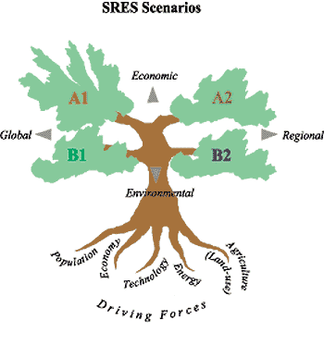
IPCC SRES
Intergovernmental Panel on Climate Change (1988)
international body for assessing the science related to climate change, to provide policymakers with regular assessments of the scientific basis of climate change, its impacts and future risks, and options for adaptation and mitigation
Special Report on Emission Scenarios
SRES scenarios cover a wide range of the main driving forces of future emissions, from demographic to technological and economic developments
Source: www.ipcc.ch

Slide 5
Top-down and bottom-up approaches of regional modelling
Top-down approach
relies on existing aggregate level results (forecast) and decompose it to the regional level – ‚satellite’ models
regional disaggregation, regionalisation, regional downscaling
the interaction between regions is only sketched
Bottom-up approach
build a full-fledged regional model in which regions are interlinked
the aggregated national values of the relevant variables are obtained by aggregating regional or sectoral values using appropriate weights
large data and computation requirement
Mixed (hybrid) approaches (Chizzolini, 2008)
combines top-down and bottom-up approaches in an interdependent system of national and regional variables
includes a feedback mechanism from regional activity into national activity, together with the top-down component that makes regional variables depend on national variables

Slide 6
Regional downscaling
The practice of “regionalisation” or regional downscaling intends to translate information available at a coarse geographical resolution (e.g. the national level) to a finer geographical scale (e.g. the regional level)
while maintaining consistency with the original dataset
Downscaling in climate models makes use of systematic dependencies between local conditions and large-scale ambient phenomena in addition to including information about the effect of the local geography on the local climate. (Benestad, 2016)
Downscaling means deriving probabilities of regional or local phenomena conditional upon a large-scale state
searching for physical connection, e.g. on the basis of local land-use patterns
statistical relationship using stochastic equations

Slide 7
The rationale for regional downscaling in IAMs
(see Grubler et al. 2007)
there is strong interest on the part of a variety of user communities to obtain information for use in national policy assessments or regional climate impact studies
the dominant decision-making paradigm is characterized by agents defined at lower degrees of spatial resolution, as represented by the nation state, municipalities, individual firms, or actors that transcend conventional “place-based” definitions altogether, such as multinational corporations
disciplines dealing with environmental consequences that usually rely on a rich tradition of place-based impact research and spatially explicit modeling of (mostly) biophysical processes, ranging from land use changes to atmospheric chemistry, or terrestrial carbon sources/sinks.

Slide 8
Requirements to be fulfilled by downscaling methods
(see Grubler et al., van Vuuren et al. 2010)
Some form of consistency with existing local scale data (e.g., with the historical period or base year)
Consistency with the original source (the scenario data at the much coarser scale)
Transparency and internal consistency, in terms of a well-defined methodology
The ability to be scenario specific
The ability to describe appropriate structural changes over time (such as internal migration, urbanisation)
Plausibility of the results (e.g. no negative population)

Slide 9
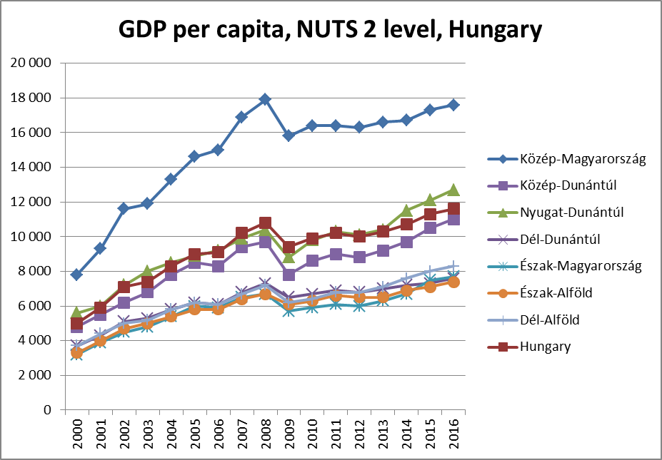
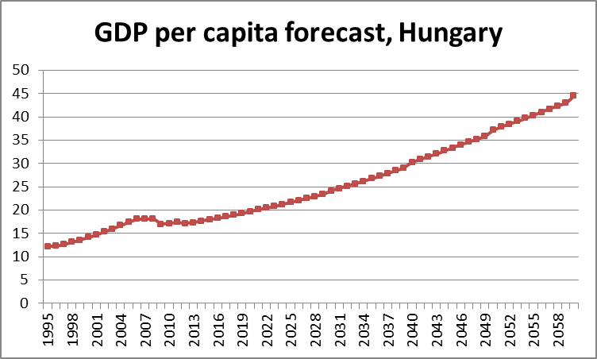
Regional downscaling in economic forecasting
Long-term, regionally disaggregated forecast

Slide 10
Regional downscaling methods
Linear/proportional downscaling
Convergence downscaling
Constant trend approach
Conditional modelling
Using a functional form for the growth rates at the regional level
More complex methods

Slide 11
Linear/proportional downscaling
(e.g. Gaffin et al. 2004)
Each country’s annual growth rate for population or GDP, at any year, is set equal to the world regional growth rate within which each country resides
mathematically equivalent to keeping the fractional share of each country’s population or GDP, relative to the regional population or GDP, constant, at the base year value, for the duration of the forecast period
excludes change in national disparities within world regions (convergence, divergence)
applicable in cases where
changes are relatively small
the differences between the units on the finer scale are relatively small
there is no information available to distinguish between units

Slide 12
Convergence downscaling
assumes some level of convergence (complete or partial) to an average world regional value, which tends to assure that the local outcome is dependent on the pathway of the larger unit
The rate of convergence depends on the selection of the convergence year

Slide 13
Constant trend approach
(e.g. Gaffin et al. 2004)
it makes use of recent historical data to estimate current trends in fractional shares and then to hold these trends constant over the forecast period
e.g. simple linear regression
two alternatives:
the trend in fractional share of regional population (income, …) size is kept constant
the trend in fractional share of the regional population (income, …) growth rate is kept constant
problem: a declining local fractional share could lead to negative population sizes if extrapolated for sufficiently long periods

Slide 14
Conditional modelling
(e.g. van Vuuren et al. 2007)
models operate at a finer scale (e.g. RCM) and are conditional on results and/or assumptions with a coarser resolution (e.g. GCM)
the conditions set to the fine-scale model form the means to downscale information which can include the scenario storyline or one or more quantitative results
a fully developed RCM is driven by boundary conditions derived from a GCM
it can be used only if there is sufficient information about the downscaled indicators and their relationships to other parameters at the finer scale

Slide 15
Using a functional form for the growth rates at the regional level
(Riahi et al. 2005)
estimate a mathematical equation for the relationship between GDP growth rates and GDP per capita at the world regional level, which may be SRES scenario-dependent
the equation defines the growth path of individual countries within a specific world region
it describes conditional (scenario-dependent) convergence across the different countries of a given world region)
the sum of the GDP of the countries does not necessarily add up to the world region’s total
correct for the deviation from the regional total, by formulating a simple non-linear optimization problem
individual countries are assumed to follow a (scenario-specific) regional, reference GDP growth trajectory and where the overall regional GDP growth scenario is used as a constraint in the optimization algorithm
Sub-national scenario downscaling methodology may explicitly consider structural change and urbanisation (urban-rural income differences) (Grubler et al. 2007)

Slide 16
Regional downscaling methods
Source: Riahi et al.

Slide 17
Further methods
(Trzaska & Schnarr 2014)
Spatiotemporal Methods:
Canonical Correlation Analysis (CCA)
Singular Value Decomposition (SVD)
allow for the study of interrelationships among spatially distributed coarse simulations and observed local-scale variables by determining the sets of patterns that have the strongest relationships over time
both methods determine pairs of spatial patterns that have the strongest association, but CCA maximizes temporal correlations, while SVD maximizes the covariance
Artificial Neural Network (ANN)
an algorithm that transforms an input data into an output data using stepwise nonlinear functions
Self-Organizing Map (SOM)
during the training of the model, SOM analyzes the input (large-scale variable) and associates it with the output (local-scale variable), simultaneously

Slide 18
References
Benestad, R. (2016) Downscaling climate information. Oxford Research Encyclopedia, Climate Science
Chizzolini, B. (2008) National and Regional Econometric Models. In: Capello, R., Camagni, R., Chizzolini, B., Fratesi, U.: Modelling Regional Scenarios for the Enlarged Europe, Springer-Verlag Berlin Heidelberg
Costa, M. Máñez, S. Schulze, J. Hirschfeld, D. Rechid, L. Bieritz, C. Lutz, A. Nieters, B. Stöver, M. Jahn, M.-C. Rische, E. Yadegar, A. Schröder, G. Hirte, S. Langer, S. Tscharaktschiew, K. Eisenach and J.M Steinhäuser (2016) Synthesis of existing regional and sectoral economic modelling and its possible integration with regional earth system models in the context of climate modelling. Report 27. Climate Service Center Germany, Hamburg.
Gaffin, S.R., Rosenzweig, C.R., Xing, X., Yetman, G. (2004) Downscaling and Geo-spatial Gridding of Socio-Economic Projections from the IPCC Special Report on Emissions Scenarios (SRES)
Grubler, A. et al. (2007) Regional, national, and spatially explicit scenarios of demographic and economic change based on SRES, Technological Forecasting & Social Change 74 (7) 980-1029
Riahi, K., P. Kolp, A. Grubler (2005) National Scenarios of Economic Activity (GDP)—A Downscaling Exercise Based on SRES. IR-05-063, International Institute for Applied Systems Analysis, Laxenburg, Austria
Trzaska, S., Schnarr, E. (2014) A review of downscaling methods for climate change projections. USAID, Washington, D.C.
Vale, P.M. (2016) The changing climate of climate change economics. Ecological Economics 121, 12-19
van Vuuren, D.P., Smith, S.J., Riahi, K. (2010) Downscaling socioeconomic and emissions scenarios for global environmental change research: a review. Climate Change, 1, 393-404

Slide 19
Thank You for Your attention!
zsibok@rkk.hu
Project no. 120004 has been implemented with the support provided from the National Research, Development and Innovation Fund of Hungary, financed under the K_16 funding scheme.

