Slide 1


  HOW TO IMPLEMENT THE CE PRINCIPLES IN POLAND ASAP?
  Małgorzata Grodzicka-Kowalczyk
  Maciej S. Kowalczyk
APRIL 2018

Slide 2

CEL SPOTKANIA
  Extract:
  Regional self-goverment policy is the best solution to involved all steckholders in circular economy process.
  That's way we should creat not just a strategy but programmes documents.
  The difference is that programmes have: action plans, budgets and timetable.

Slide 3
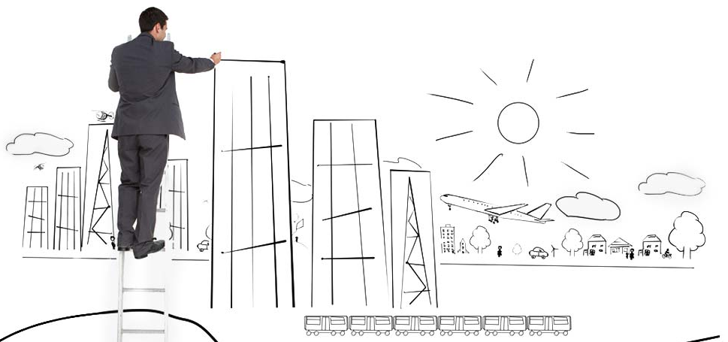
PHENO HORIZON OLP Ltd. Company
Pheno Horizon is an Advisory Office focused on development-related activities. Our main task is to build bridges between self-government and commercial companies in the process of searching for effective solutions.

Slide 4
OUTLINE
  Is the CE idea sth new?
  Are other processes of change in Poland a combination of ideas, tools that will help in the implementation of CE?
  Model of the revitalising process in the Pabianice City example.
  What are the implementation mechanisms for CE?
  Method of scanning the city in the example of Amsterdam and Glasgow.
  Conclusion.

Slide 5

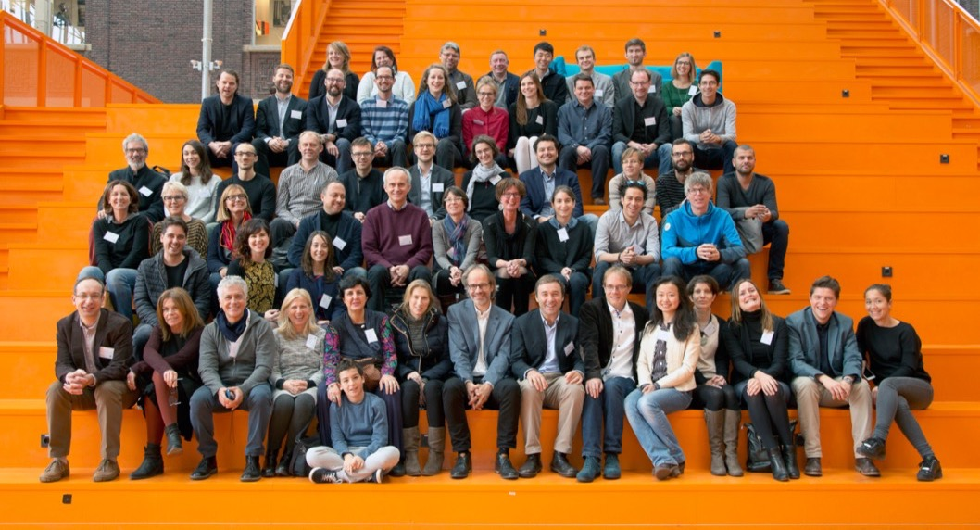
Resource Managemnt in PERi-urban Areas: Going Beyond Urban Metabolism
The Pheno Horizon joined the REPAiR Project consortium in 2015 year. Since October 2016, we are looking together for solutions to analyze and effectively implement the principles of development with respect to the CE principles.

Slide 6

Is the CE idea sth new?
  Daniel Bell (May 10, 1919 – January 25, 2011, Cambridge, Massachusetts) was an American sociologist, professor of Columbia University in New York (1959 – 69) and Harvard University, Cambridge (since 1969).
  In 1977 Bell has pointed out the processes of limiting environmental degradation as a strong need for a mankind.
  Glass containers which contains preserves for winter serve for many years.

Slide 7
Model of the revitalising proces.
Social sphere
and:
Economic sphere
Functional and spatial Sphere
Technical Sphere
Environmental Sphere
"Revitalization is a process of deriving from the crisis state degraded areas, conducted in a comprehensive manner, through integrated activities for the local community, space and economy, territorially focused, carried out by stakeholders revitalization based on the communal revitalization program.„
The Act of 9 October 2015 on revitalization

Slide 8

PARTNER
The most important assumptions of the revitalization process include the development of a list of effective activities in the form of projects. The developed activities must be based on local conditions: social potential, designated degraded area and the strength of the local economy.
The projects provided for in the process of revitalization of a given commune primarily have to solve major problems which exist and affect the deterioration of the quality of life of residents.

Slide 9
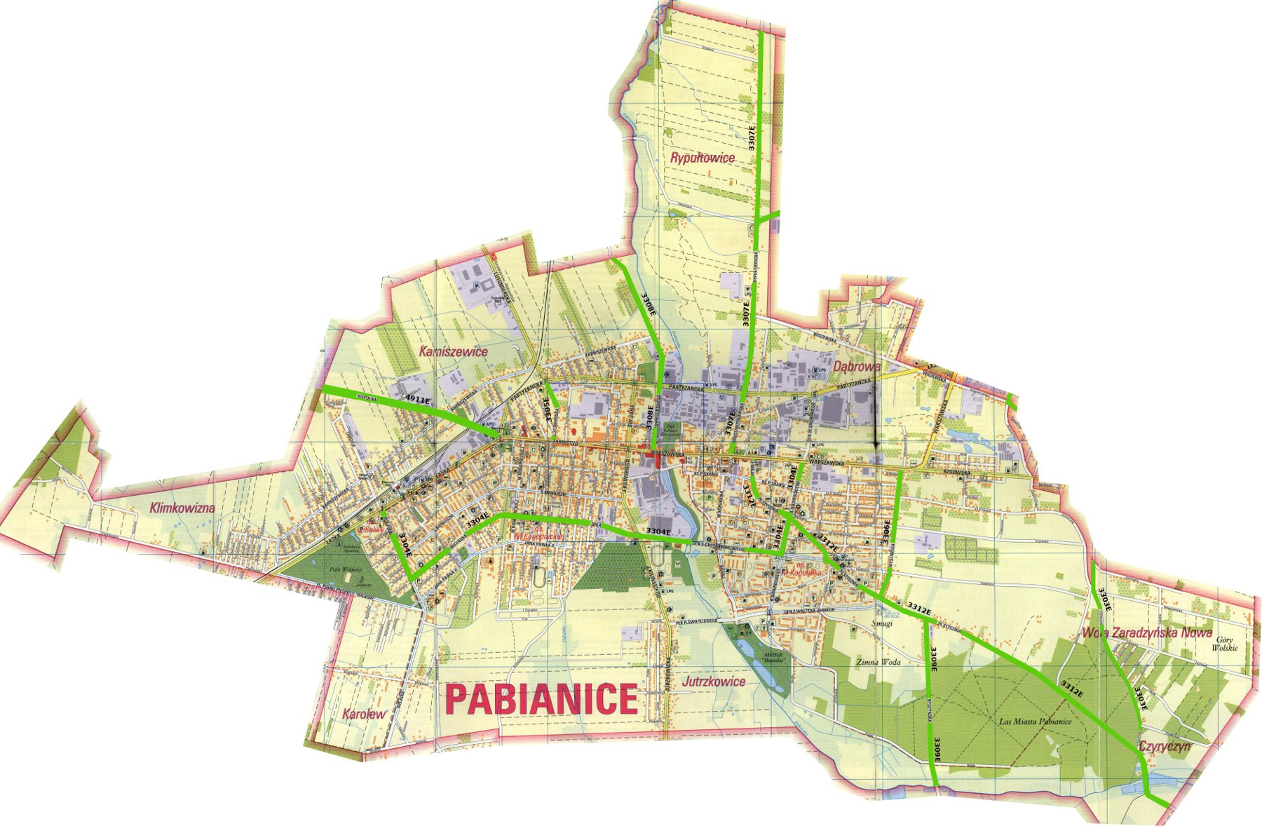
Model of the revitalising process in the Pabianice City example.
The map of the city of PABIANICE.

Slide 10
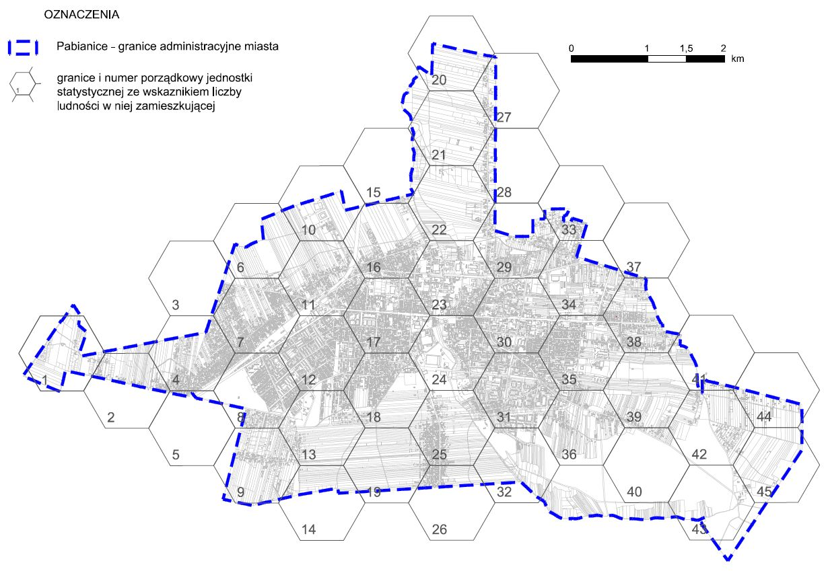
Revitalising process in the Pabianice City.
The city of PABIANICE-a division of the city into hexagonal statistical units for the purpose of carrying out diagnostic work.

Slide 11
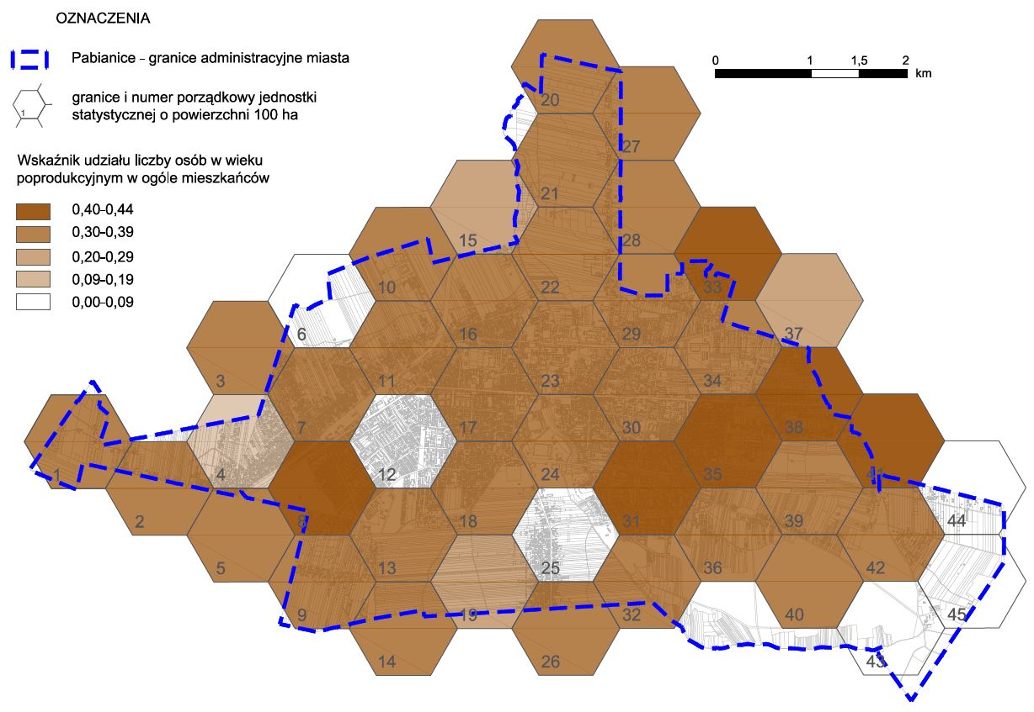
Revitalising process in the Pabianice City.
City of PABIANICE – Number of persons over 55 years living in the city, data for 2016 year.

Slide 12
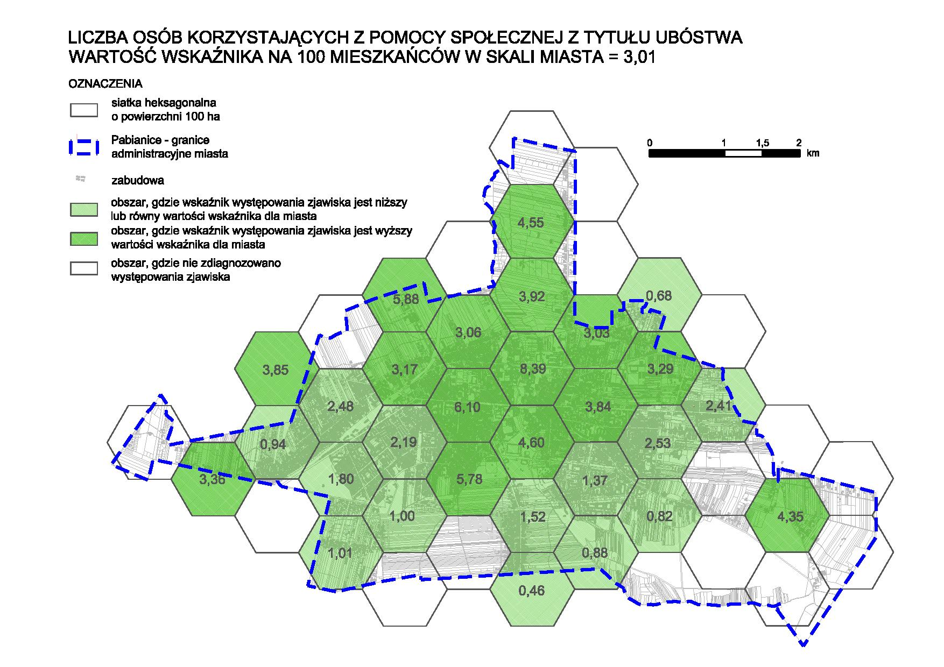
Revitalising process in the Pabianice City.
City of PABIANICE – Number of persons benefiting from social assistance; The value of the pointer to 100 inhabitants.

Slide 13
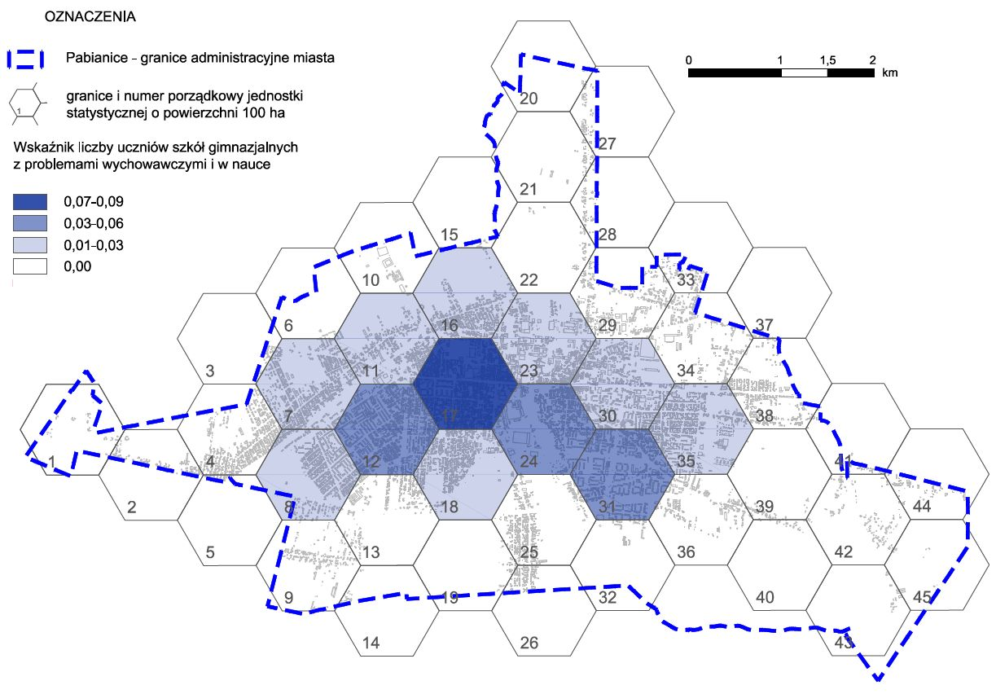
Revitalising process in the Pabianice City.
City of PABIANICE – Participation of pupils in secondary schools with educational and learning problems, according to data for 2016 year.

Slide 14
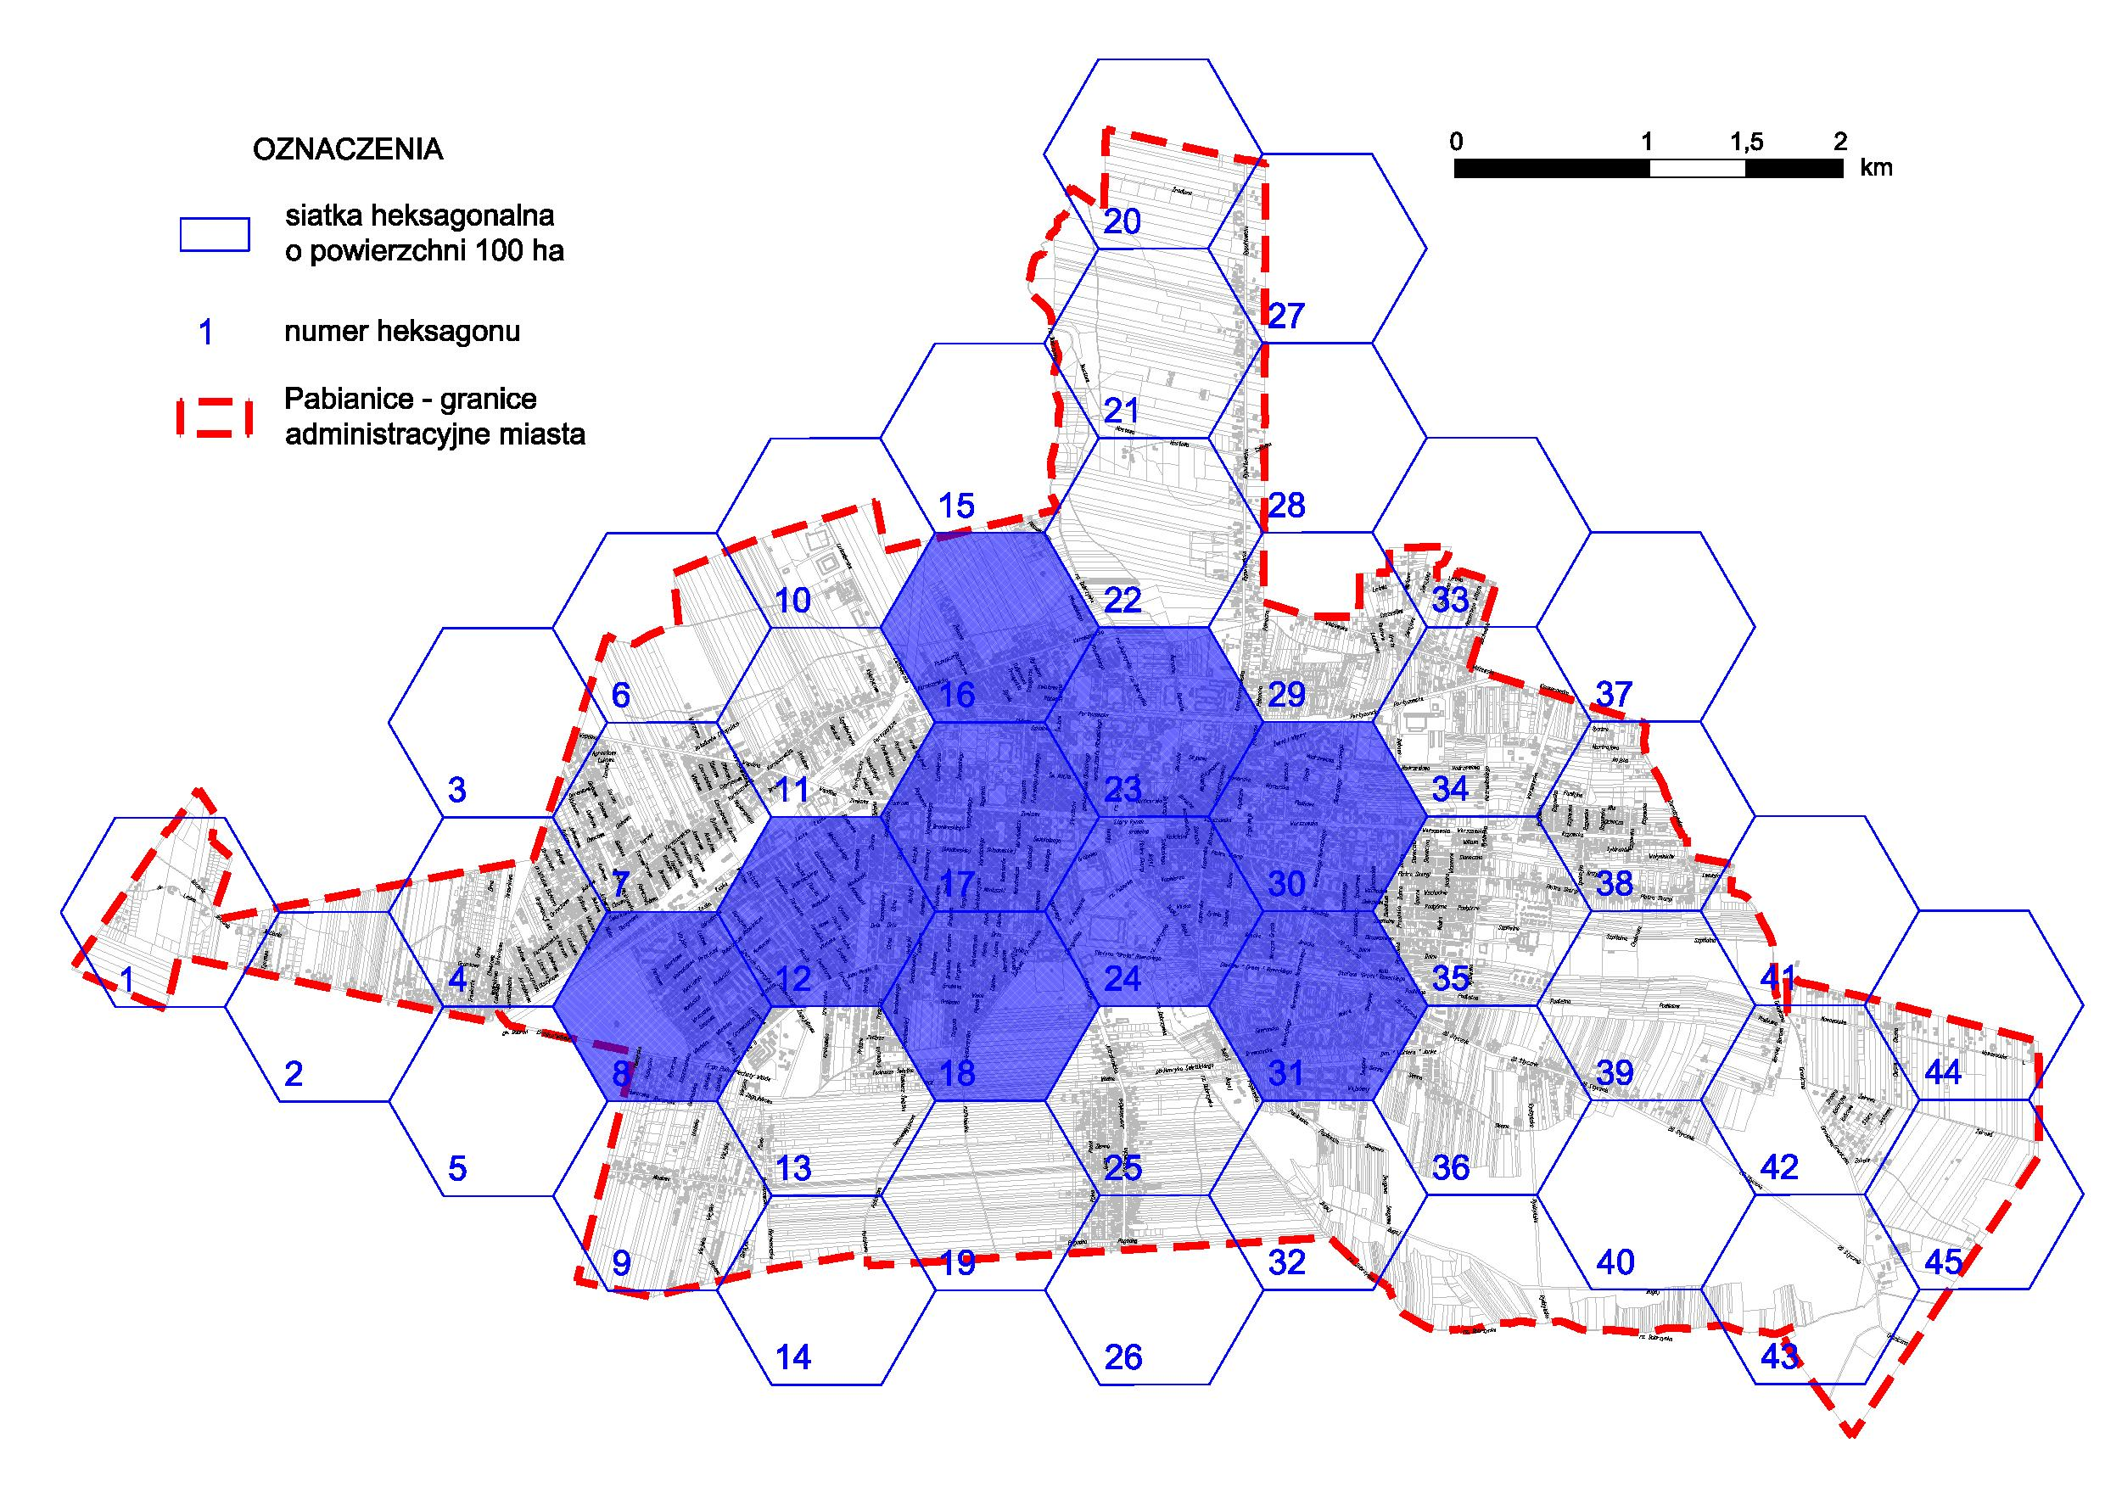
Revitalising process in the Pabianice City.
The high number of people covered by social assistance due to inability to meet basic life needs and lack of earning opportunities.

Slide 15
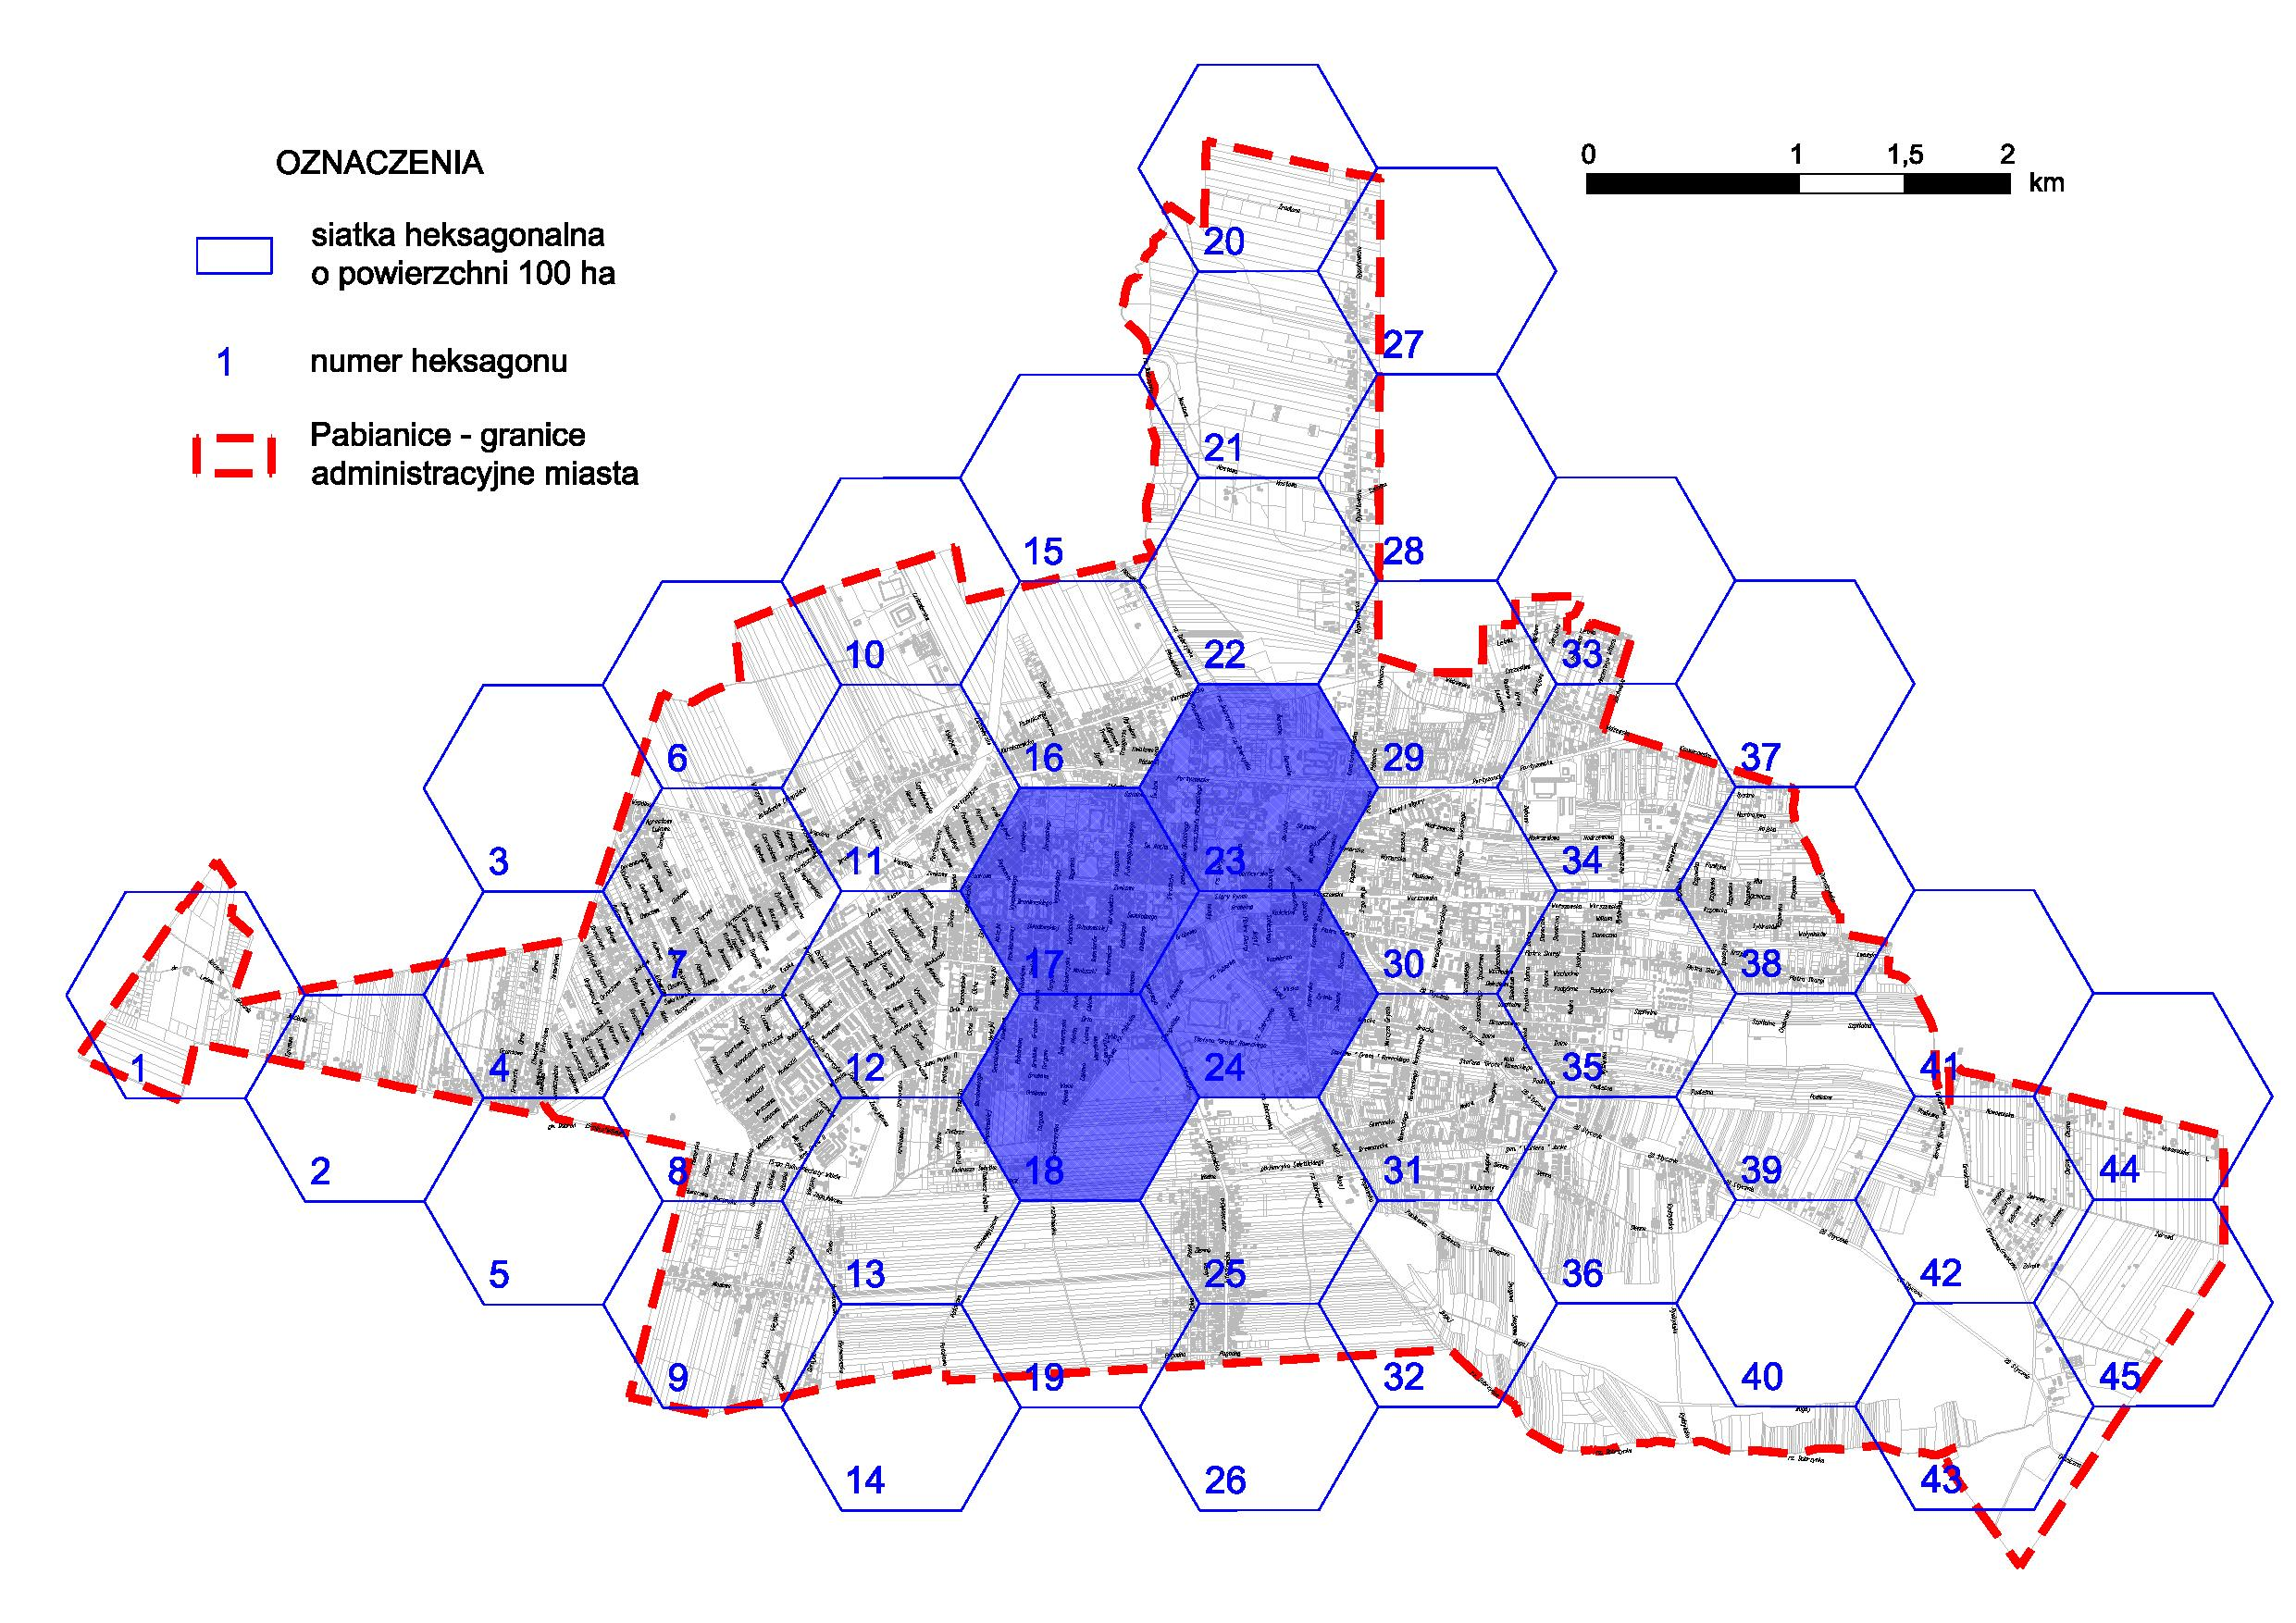
Revitalising process in the Pabianice City.
The increase in the number of assisted persons within the framework of the alcohol problem.

Slide 16
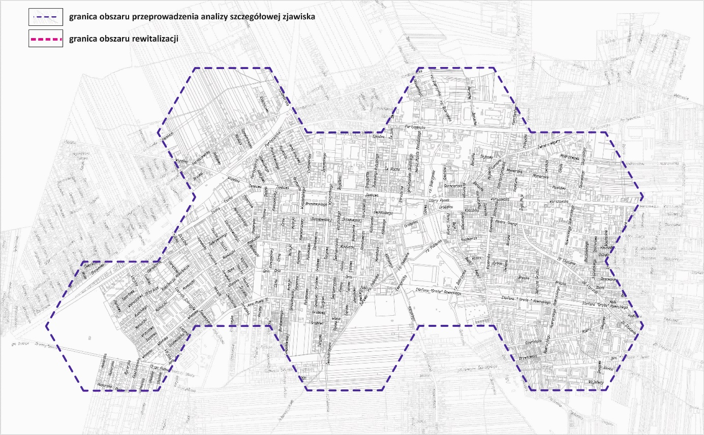
Revitalising process in the Pabianice City.
An indication of the city area within the spatial statistical units for which the social crisis situation was diagnosed.

Slide 17
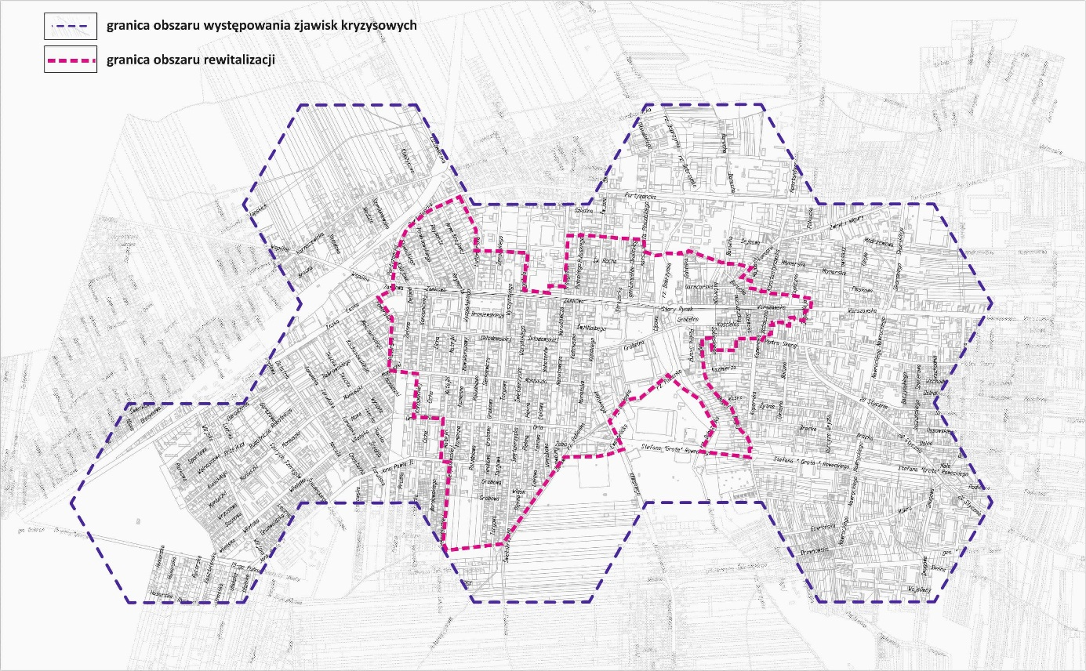
Revitalising process in the Pabianice City.
Spatial scope of the regeneration area on the background of the crisis area.

Slide 18
Revitalising process in the Pabianice City.
PROJEKT 1 | Revitalization route the Cracow chapter together with the old market in Pabianice-restore the importance of public space of the main street of the city with the market as the most important functional center and meeting place in the city.
PROJEKT 2 | „Family, ACH family...-Pabianice Program of support services”
PROJEKT 3 | Change direction-social, educational and professional activation
PROJEKT 4 | Free legal aid in the form of advice to residents of the Pabianice revitalization area
PROJEKT 5 | The management of the boulevard. Felix Krusche'go on the river Dobrzynką
PROJEKT 6 | Pabianickie Green Yard
PROJEKT 7 | Improving the performance of public utility facilities
Spatial scope of the regeneration area on the background of the crisis area.

Slide 19
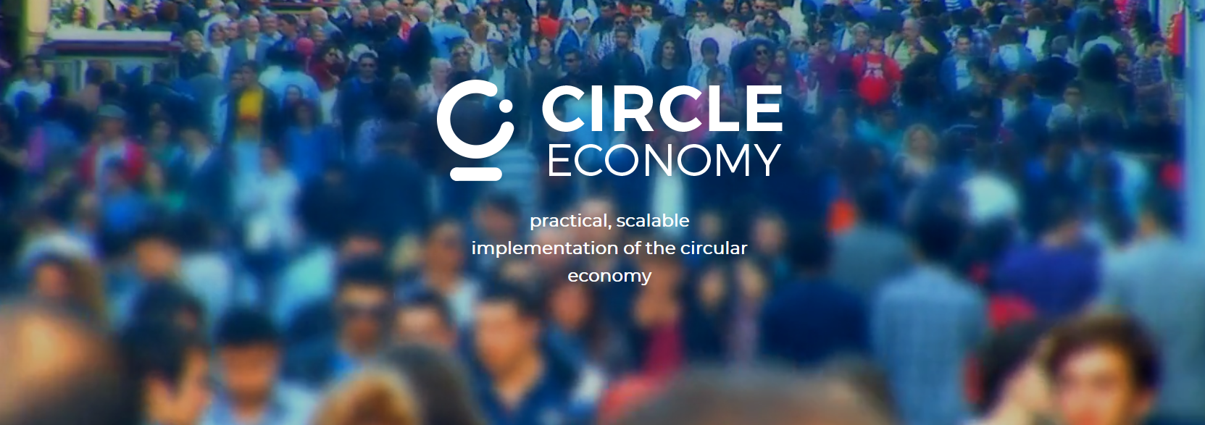
Circle Economy has begun business in 2011 as an organisation aiming to create a space for life where global prosperity is achieved in a sustainable way, creating more jobs and reinforcing environmental systems in a way that is Financially and socially responsible.

Slide 20

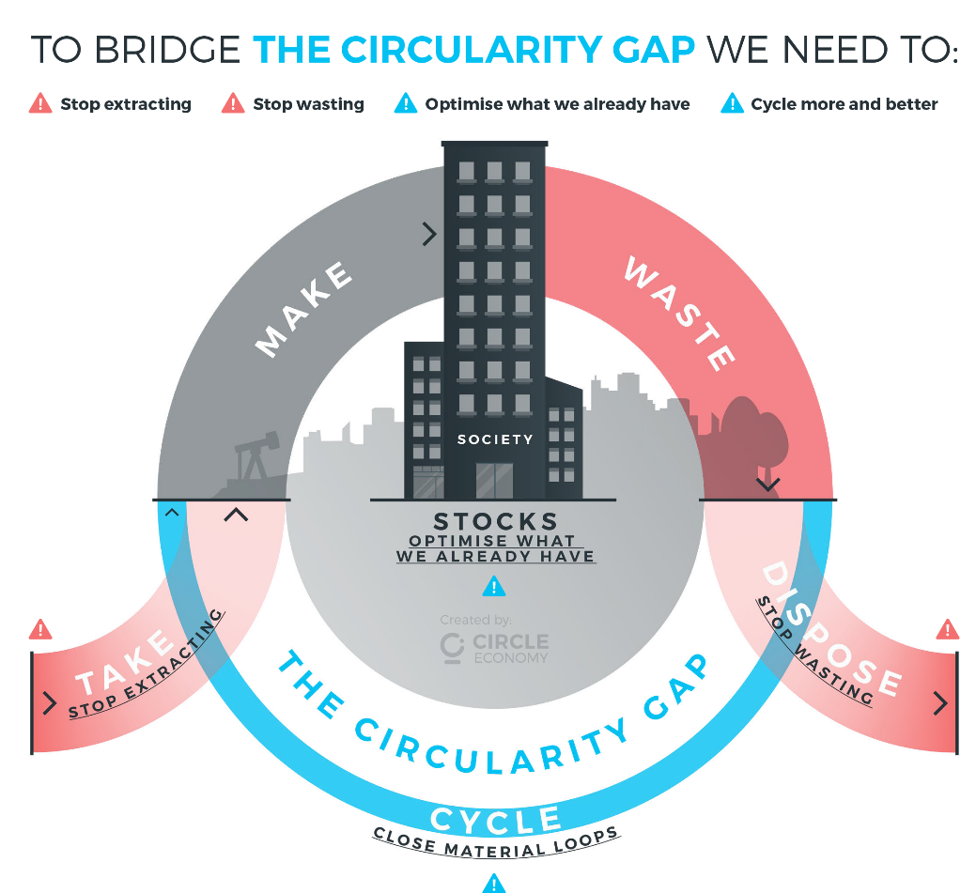
PARTNER
Call to Action
We have identified 4 steps to take action in bridging the circularity gap through leadership and action:
Build a global coalition for action
Develop a global target and action agenda
Translate global targets into local pathways for circular change
Improve our understanding of how different levers for circular change affect aspects such as material saving, value retention and climate mitigation

Slide 21
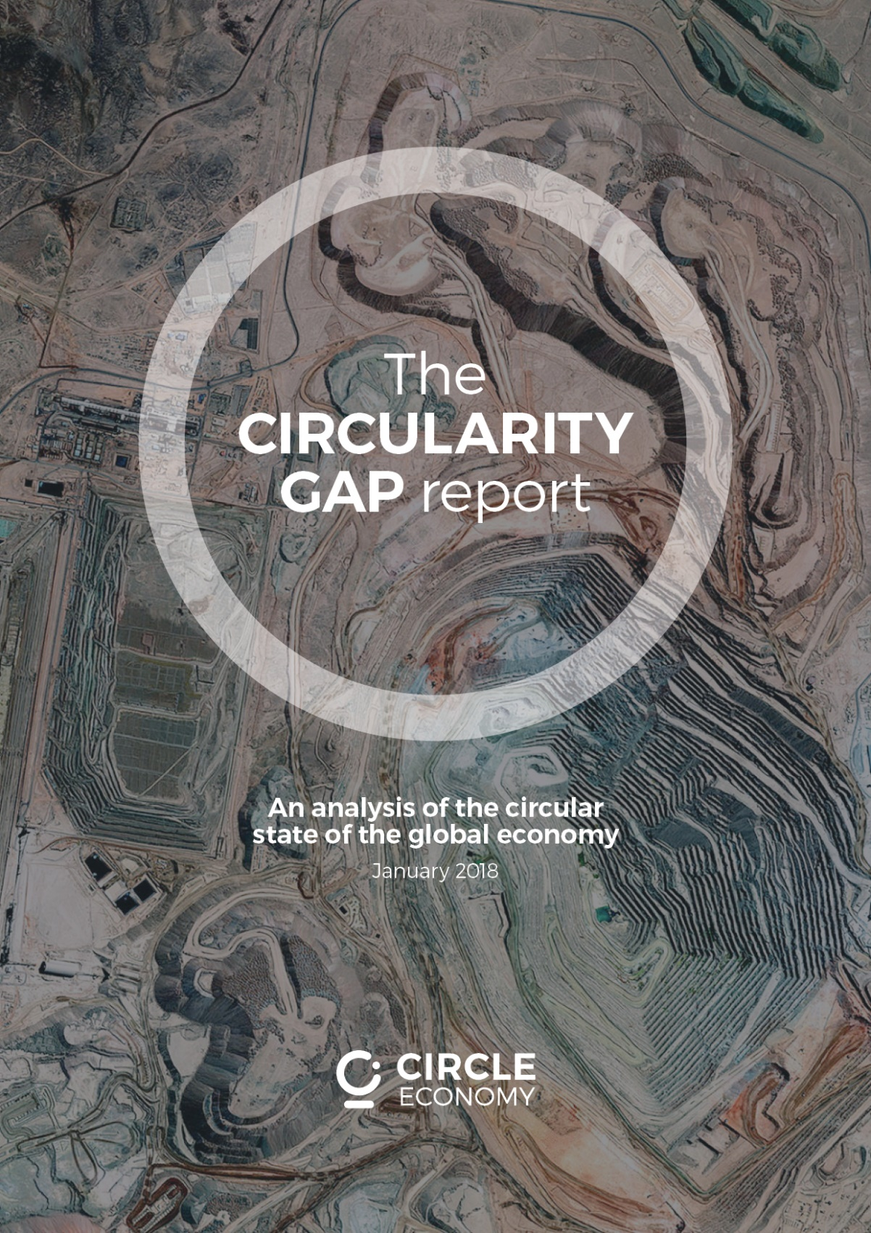
Main message of the report:
Our global economy is only in 9.1% of circular, leaving a huge „circularity gap". This worrying statistic is the main way out of this first report on Circular Economics, which reveals the methods of achieving the circularisity of the planet. A report on the gaps in Circular provides a framework and a basis for measuring and monitoring the progress in bridging the gap, from year to year.

Slide 22
Method of scanning the city in the example of Amsterdam and Glasgow.

Slide 23
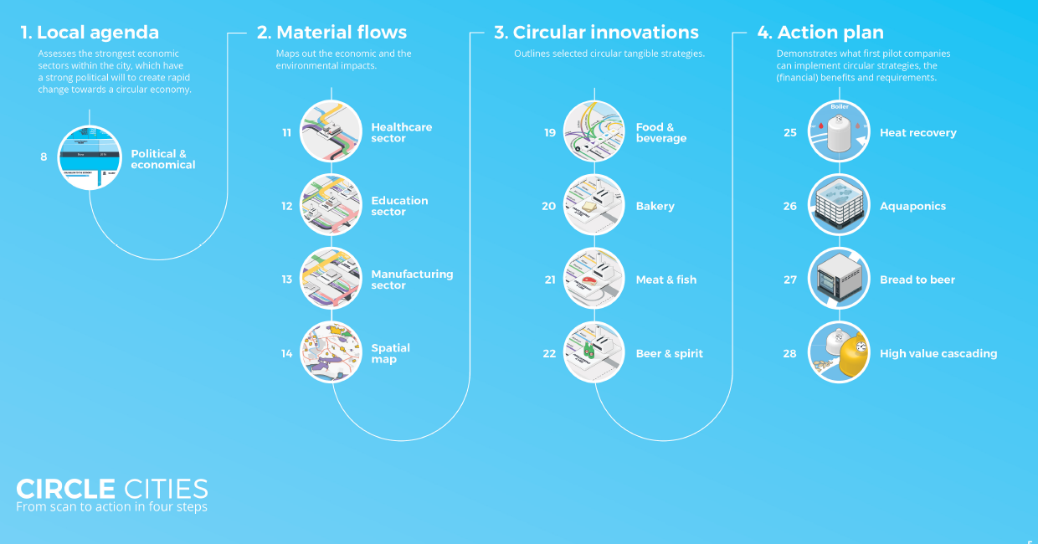
Method of scanning the city.

Slide 24
Method of scanning the city in the example of Amsterdam and Glasgow.

Slide 25
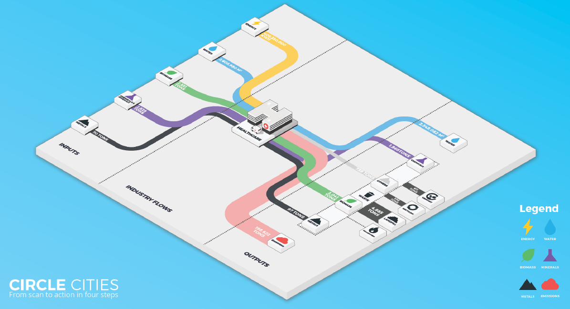
Method of scanning the city in the example of Amsterdam and Glasgow.

Slide 26
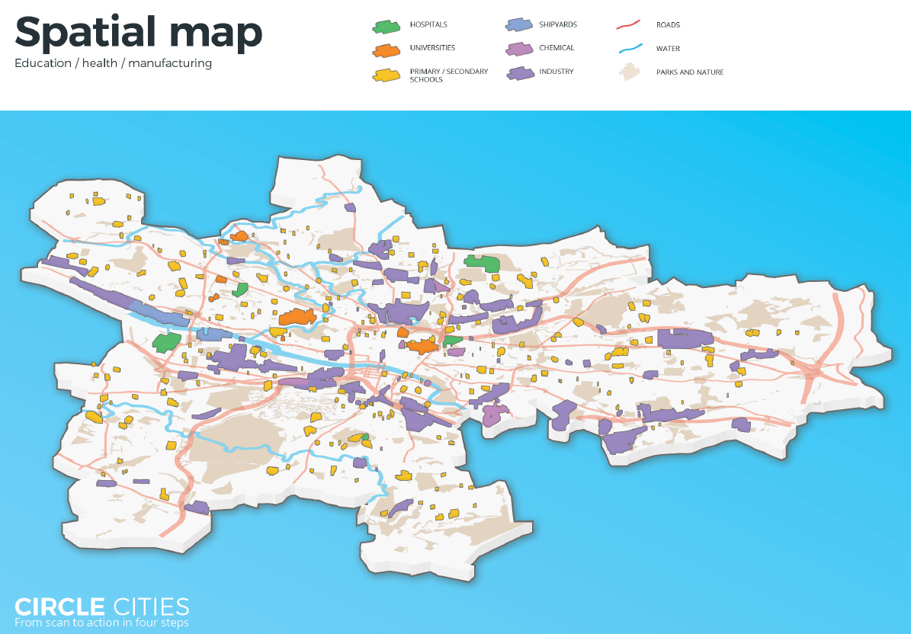
Method of scanning the city.

Slide 27

CONCLUSION
Conclusions:
These two methods, as seen in the methodological layer, are comparable, so we can expect to implement the CE idea in Poland.
My experience, however, is that we have some caution in implementing a
completely new approach.
The Cities Council Offices prefer to go through evolution than the revolution, so the link between the Circle Economy in Amsterdam and the Polish urban regeneration approach will much better facilitated implementation.

Slide 28
CONCLUSION
Conclusions:
Regional self-goverment policy is the best solution to involved all steckholders in circular economy process.
That's way we should creat not just a strategy but programmes documents.
The difference is that programmes have:
action plans, budgets and timetable.

Slide 29

Thank You
www.phenohorizon.com

