Slide 1
Green policies and the Circular Economy Round Table
Márta Somogyvári PhD
University of Pécs, Faculty of Business and Economics
Department of Quantitative Management

Slide 2
Gergely Tóth (KÖVET Association for Sustainable Economies – secretary general; University of Kaposvár – professor);
Sylvia Graczka – (HUMUSZ association, former head of the organisation; Corvinus University of Budapest);
Attila Pánovics (associate professor, University of Pécs, Faculty of Law);
Katalin Erdős (associate professor, University of Pécs, Faculty of Business and Economics)
Márta Somogyvári (University of Pécs, Faculty of Business and Economics, associate professor)

Slide 3
Economy – Business -Strategy
Society
Legal, cultural, societal, etc. framework
Economy
Business org.
Business org.
Goods, services
Biosphere
Customers (B2C, B2B, B2G, etc)

Slide 4
Switching from linear to circular economy
Society
Expectations
Company
Expectations
Government
Shareholders
Expectations
Legislation
(Profit – long term)
Strategic foresight
Image
Customers
Switching the focus from product to production process
Expectations
Driving forces from the stakeholder point of view

Slide 5
A European Strategy for Plastics in a Circular Economy
Communication on the implementation of the circular economy package: options to address the interface between chemical, product and waste legislation
Report on Critical Raw Materials and the Circular Economy
Circular Economy Monitoring Framework

Slide 6
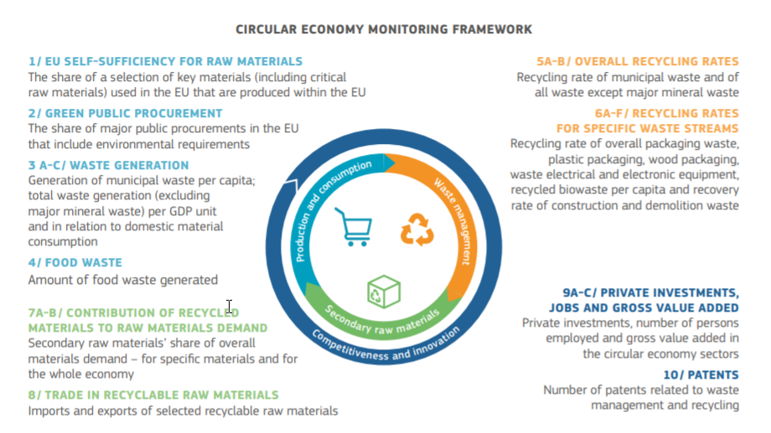

Slide 7
Is it possible to close a loop? (What about waste, energy, agriculture, industry, commerce, etc.?) Is it always green if we close the loop? What are the political constraints?
2. Whose responsibility is to close a loop? (EU, governments, business organizations, other institutions) What are the costs? Who should pay for it? Short-term and long-term impacts on various stakeholders.
3. Communication of circular economy: Is this only a marketing hype, green-washing of EU, government and/or business? Is it possible to enforce circular economy via communication and/or education?

